Slide 1
Phytoplankton Community Response to SCU Lightning Fires in Monterey Bay

Slide 2
Aeronet Aerosol Optical Depth at 500 nm

Slide 3
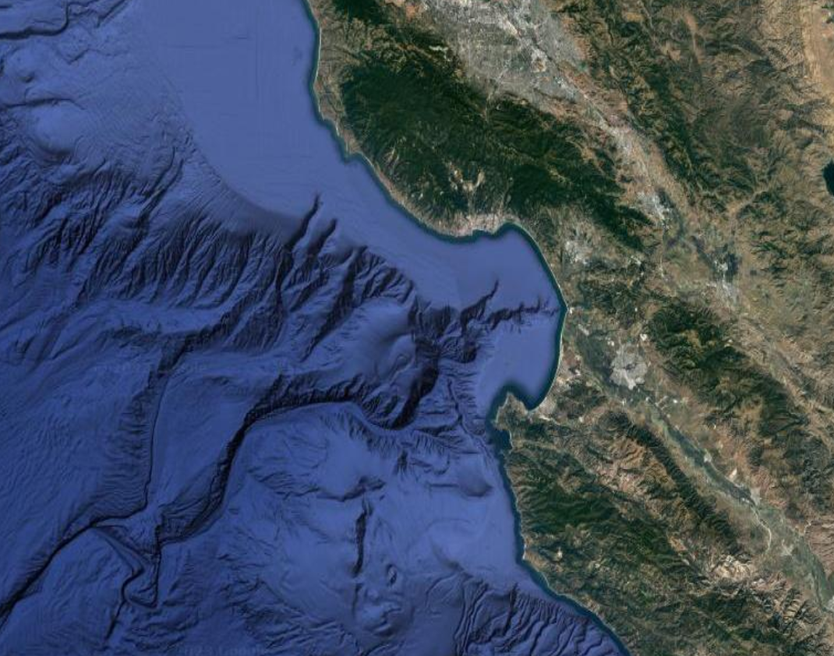


Santa Cruz Data streams
Wildfire:
Aeronet: Aerosol optical depth at 500 nm
Biology
IFCB: phytoplankton community composition, biovolume
CalHABMAP: phytoplankton community composition
Biogeochemistry
Wharf Shore Station: CO2, chlorophyll-a, conductivity, fluorescence, nitrate, dissolved oxygen, oxygen saturation, pH, radiative flux: beam attenuation coefficient, salinity, temperature transmissivity, water level
Other Forcings:
San Lorenzo Outflow
Upwelling (BEUTI, CUTI, winds)
Climate Indices (MEI, marine heatwaves)

Slide 4
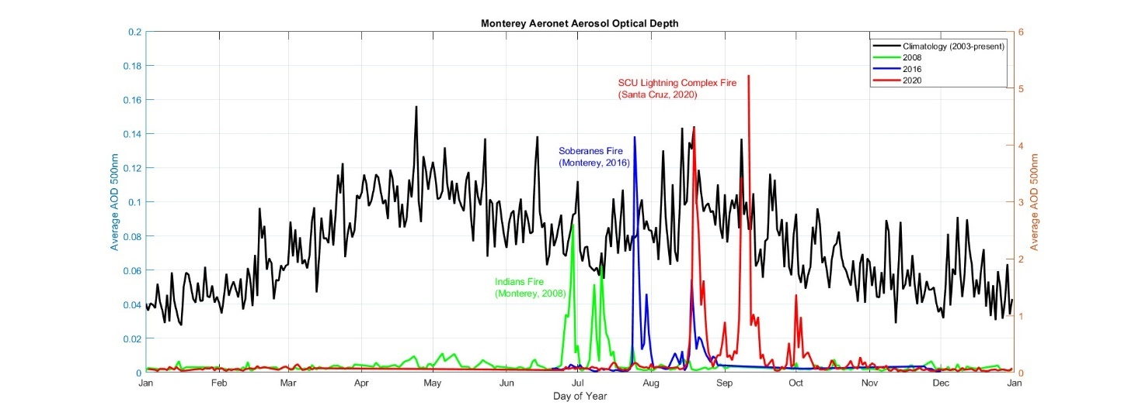
Aeronet Aerosol Optical Depth at 500nm

Slide 5
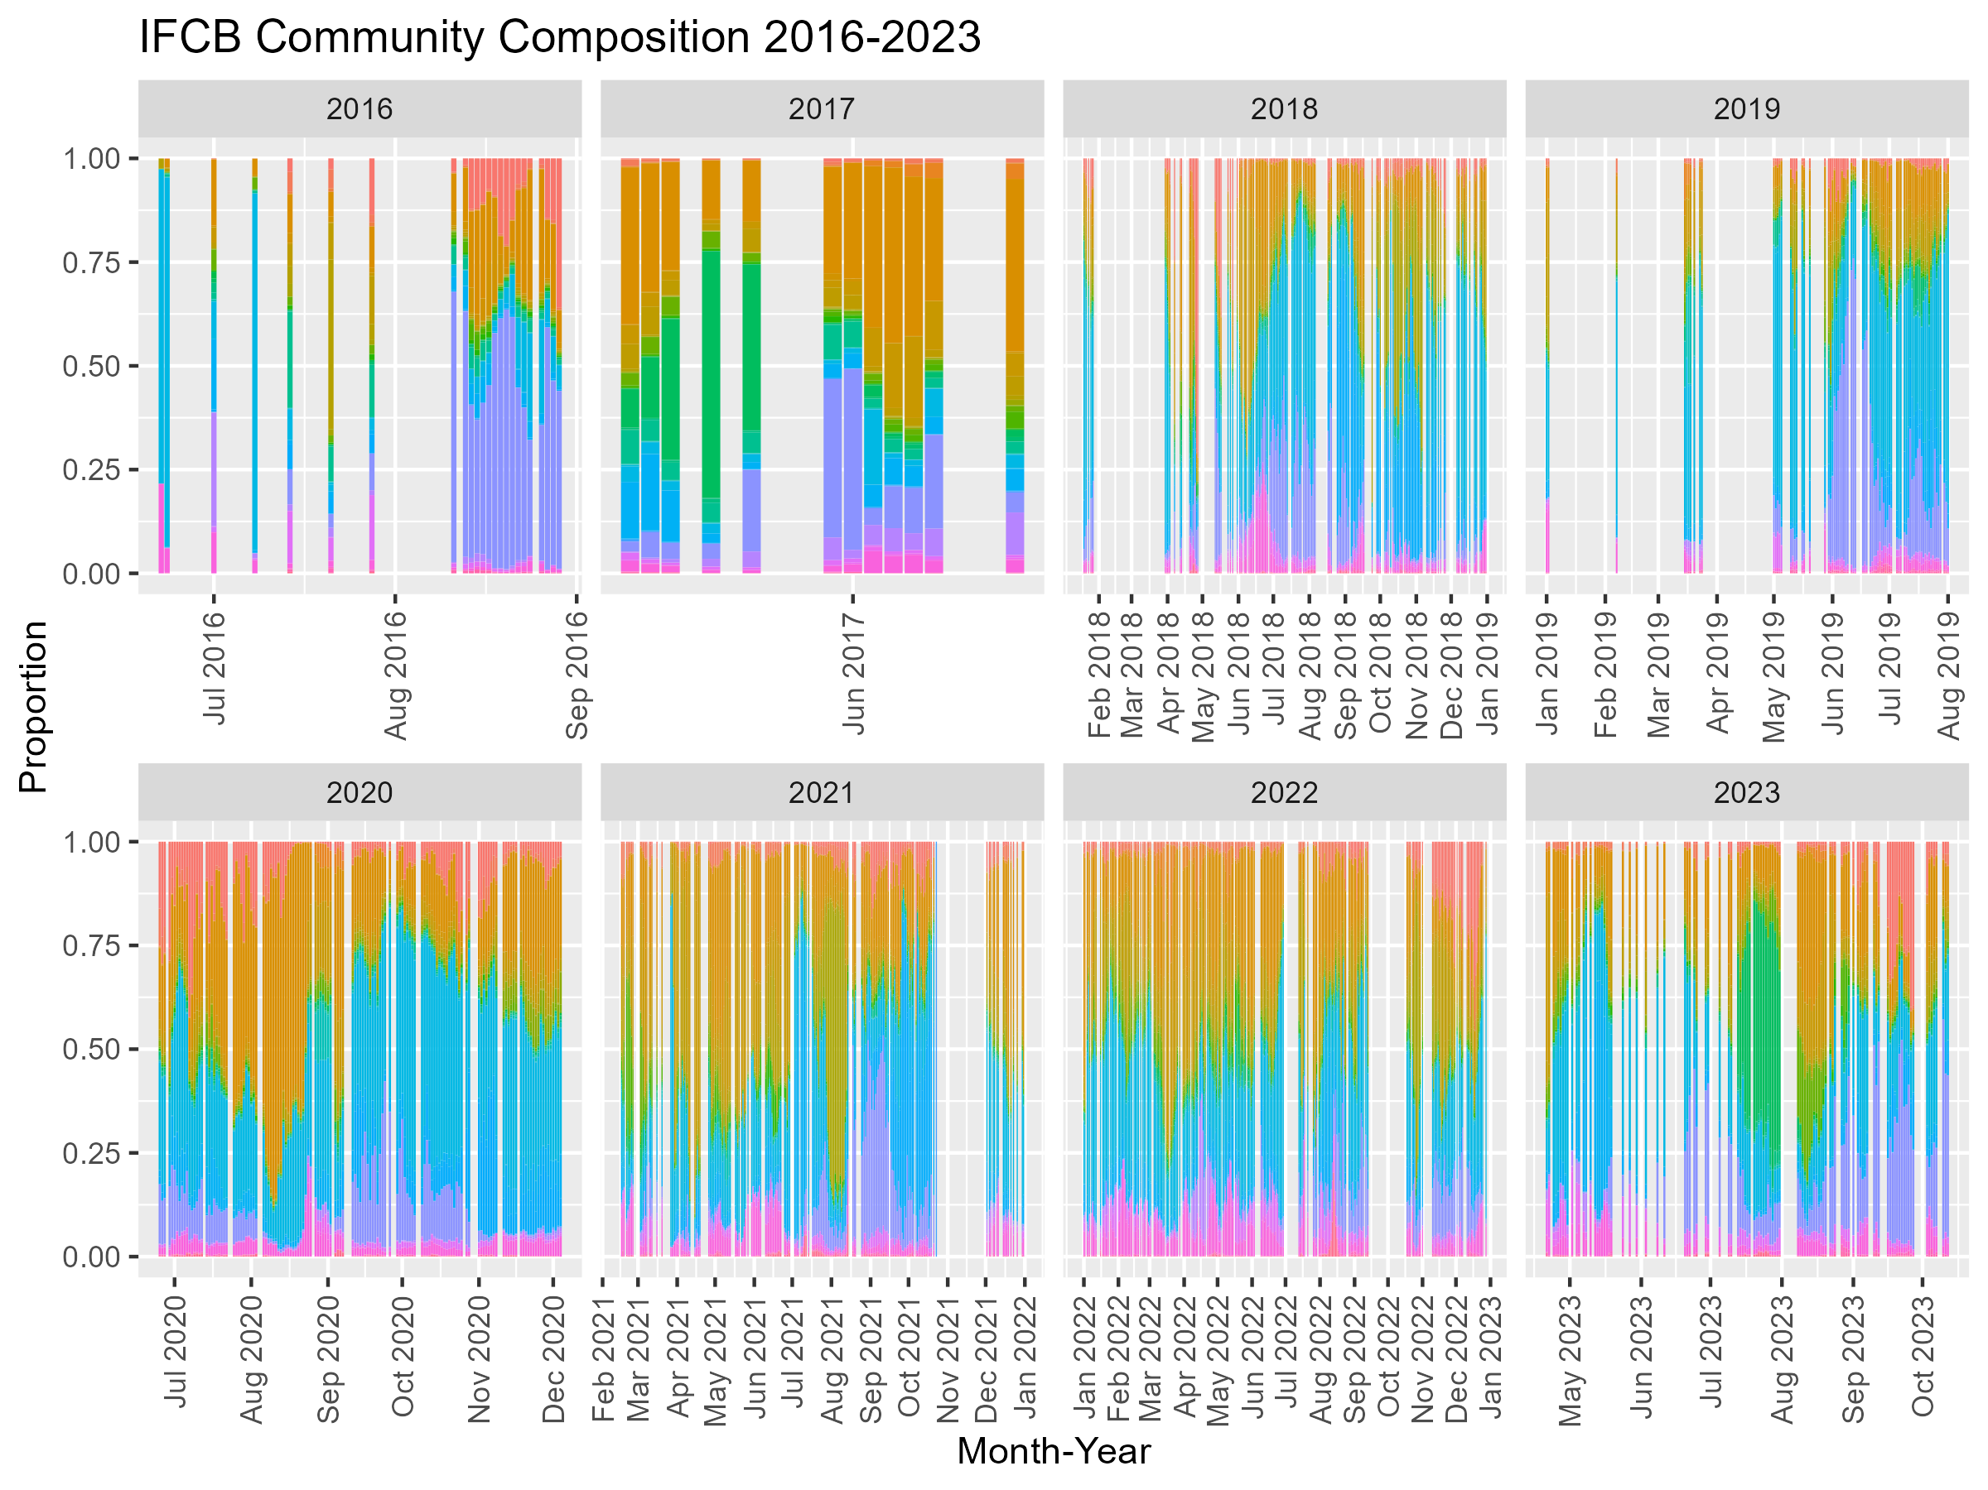
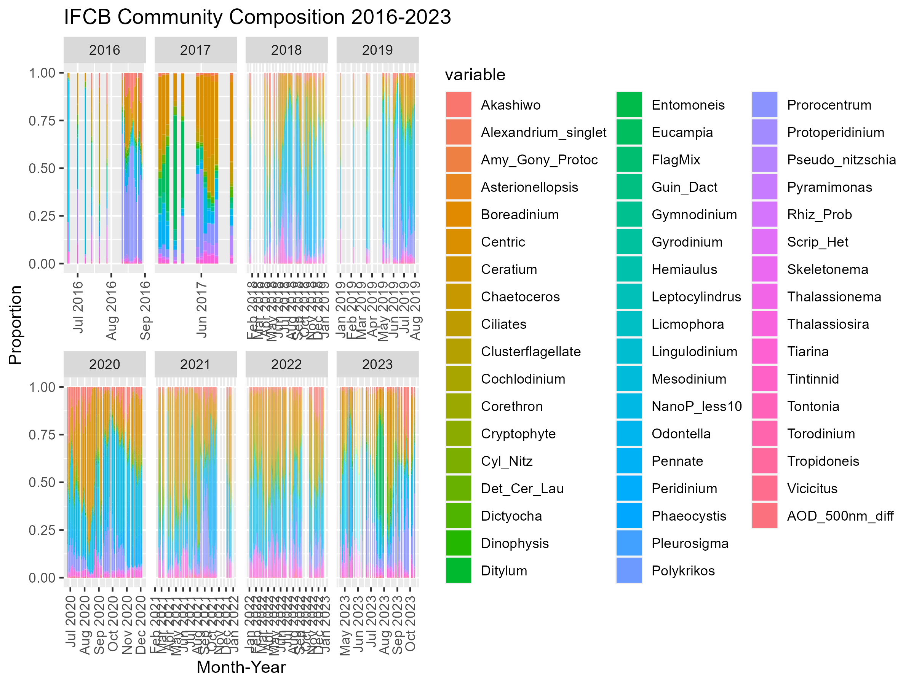
IFCB Composition

Slide 6
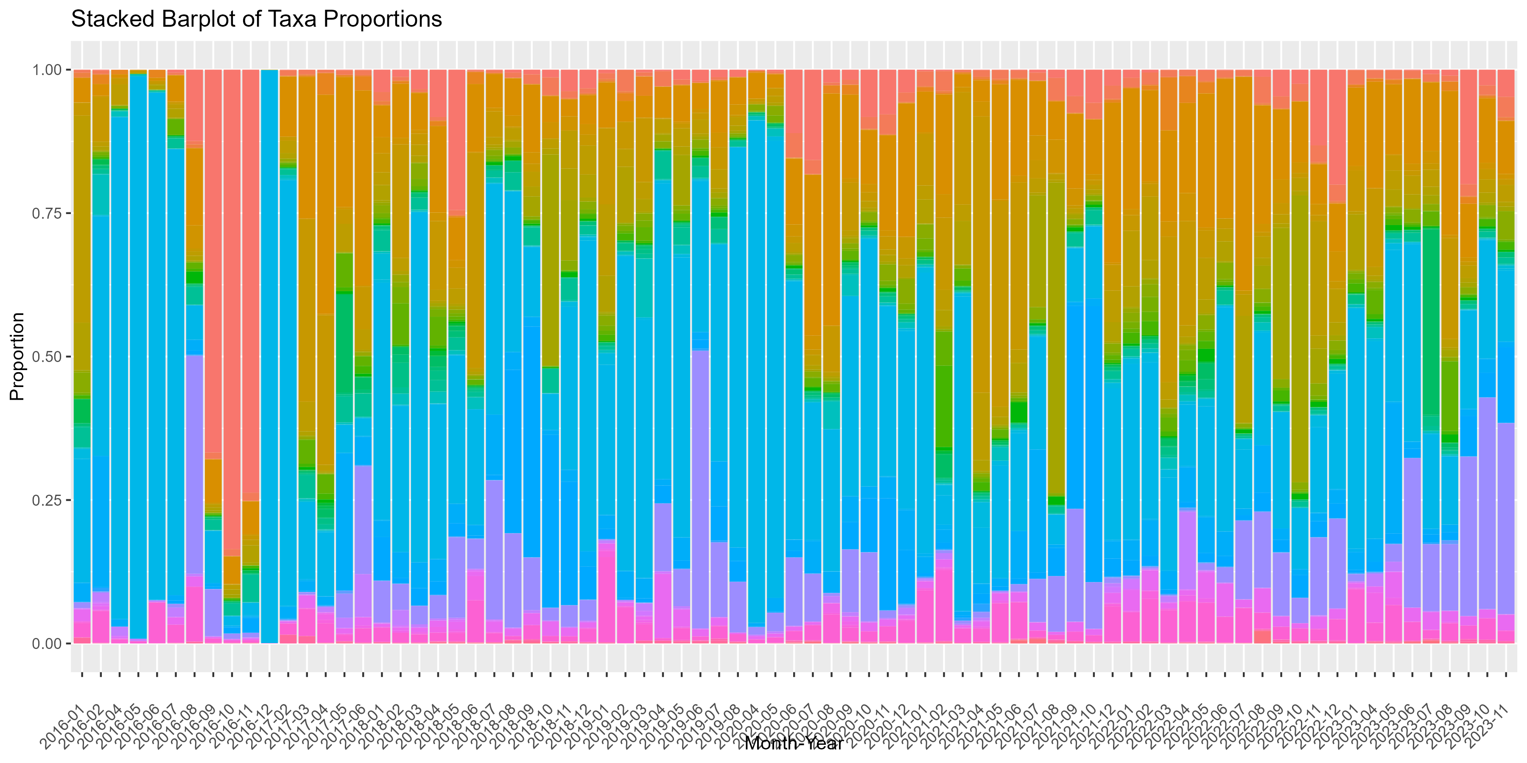
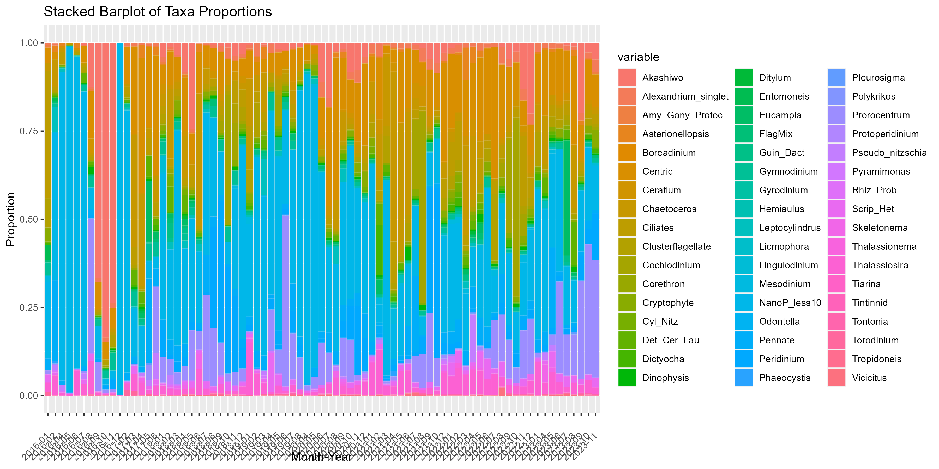
IFCB Composition

Slide 7
Phytoplankton Groups and AOD

Slide 8
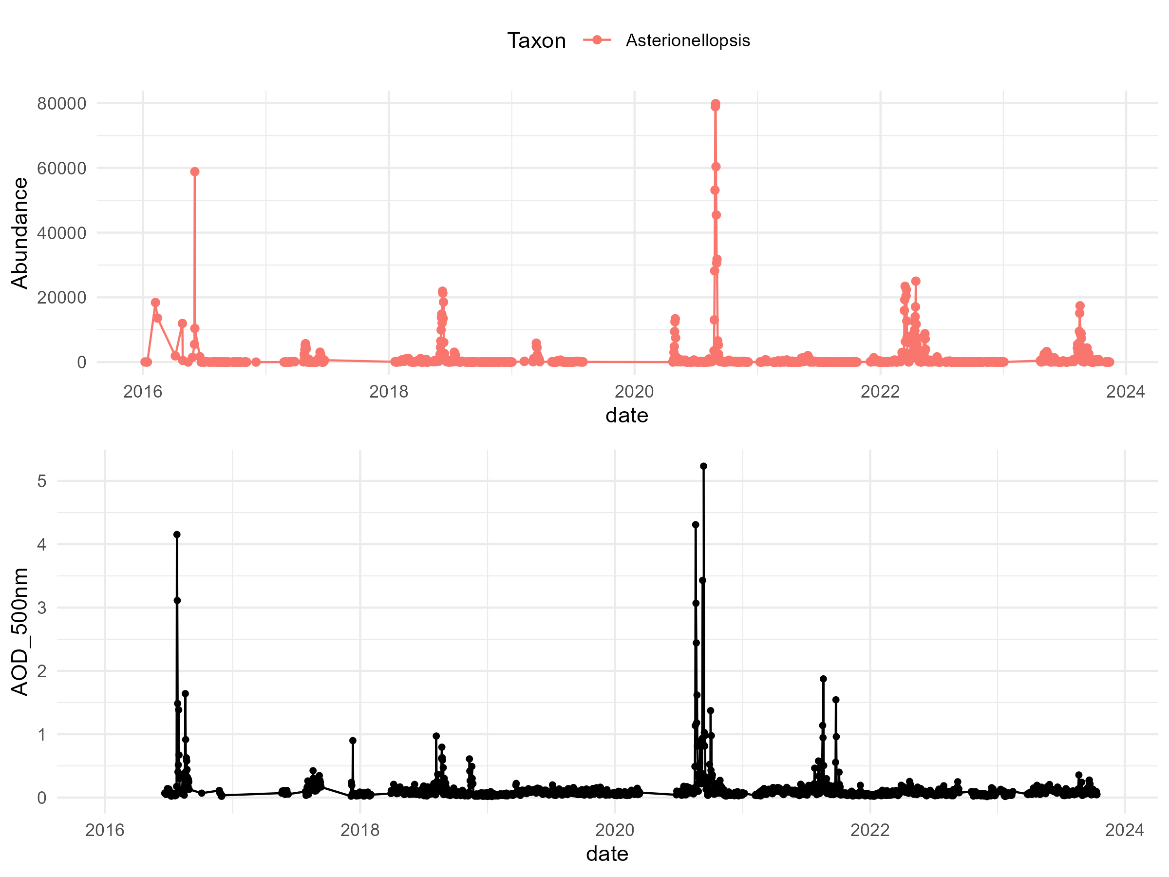
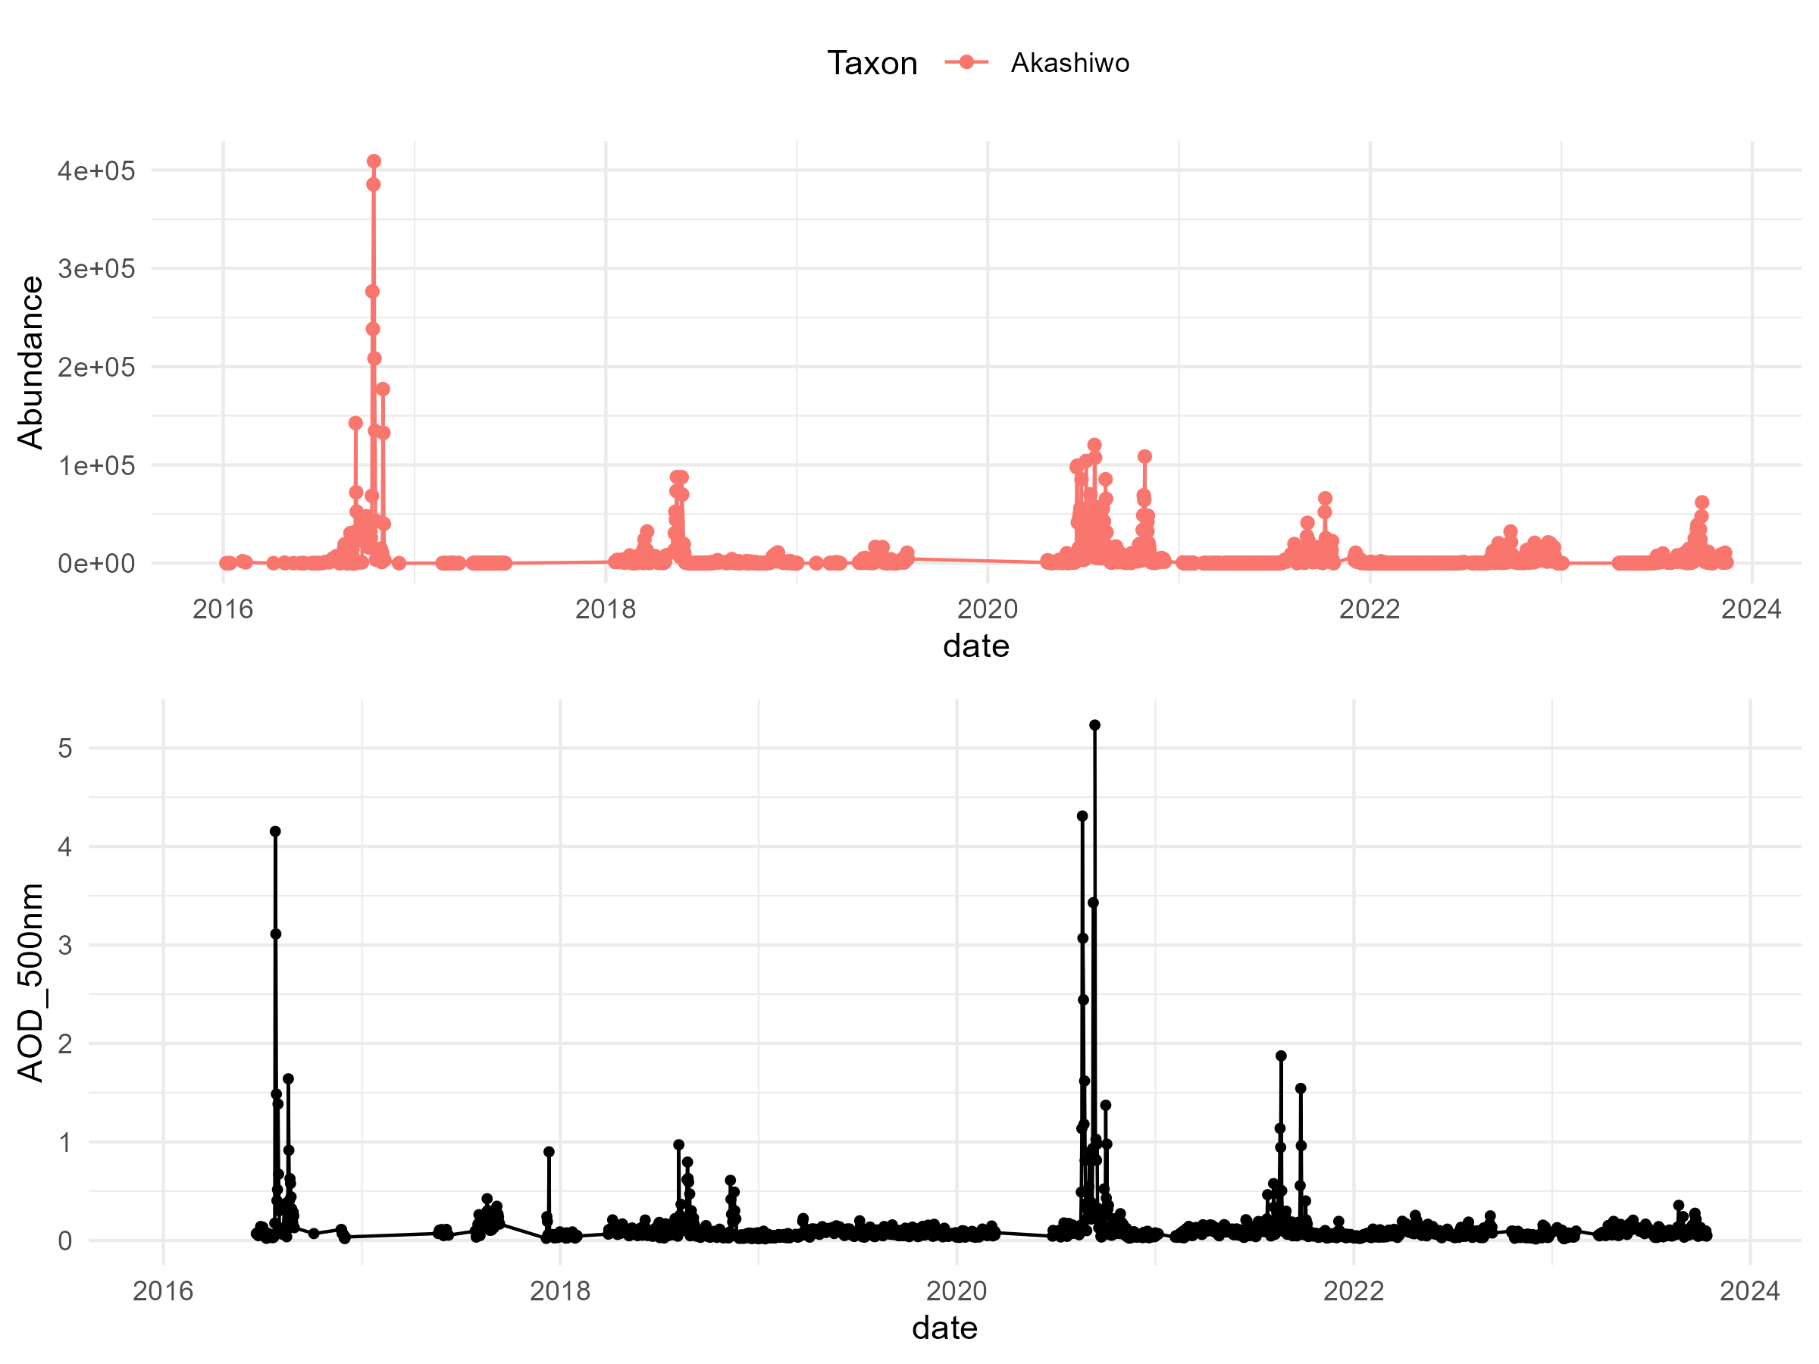
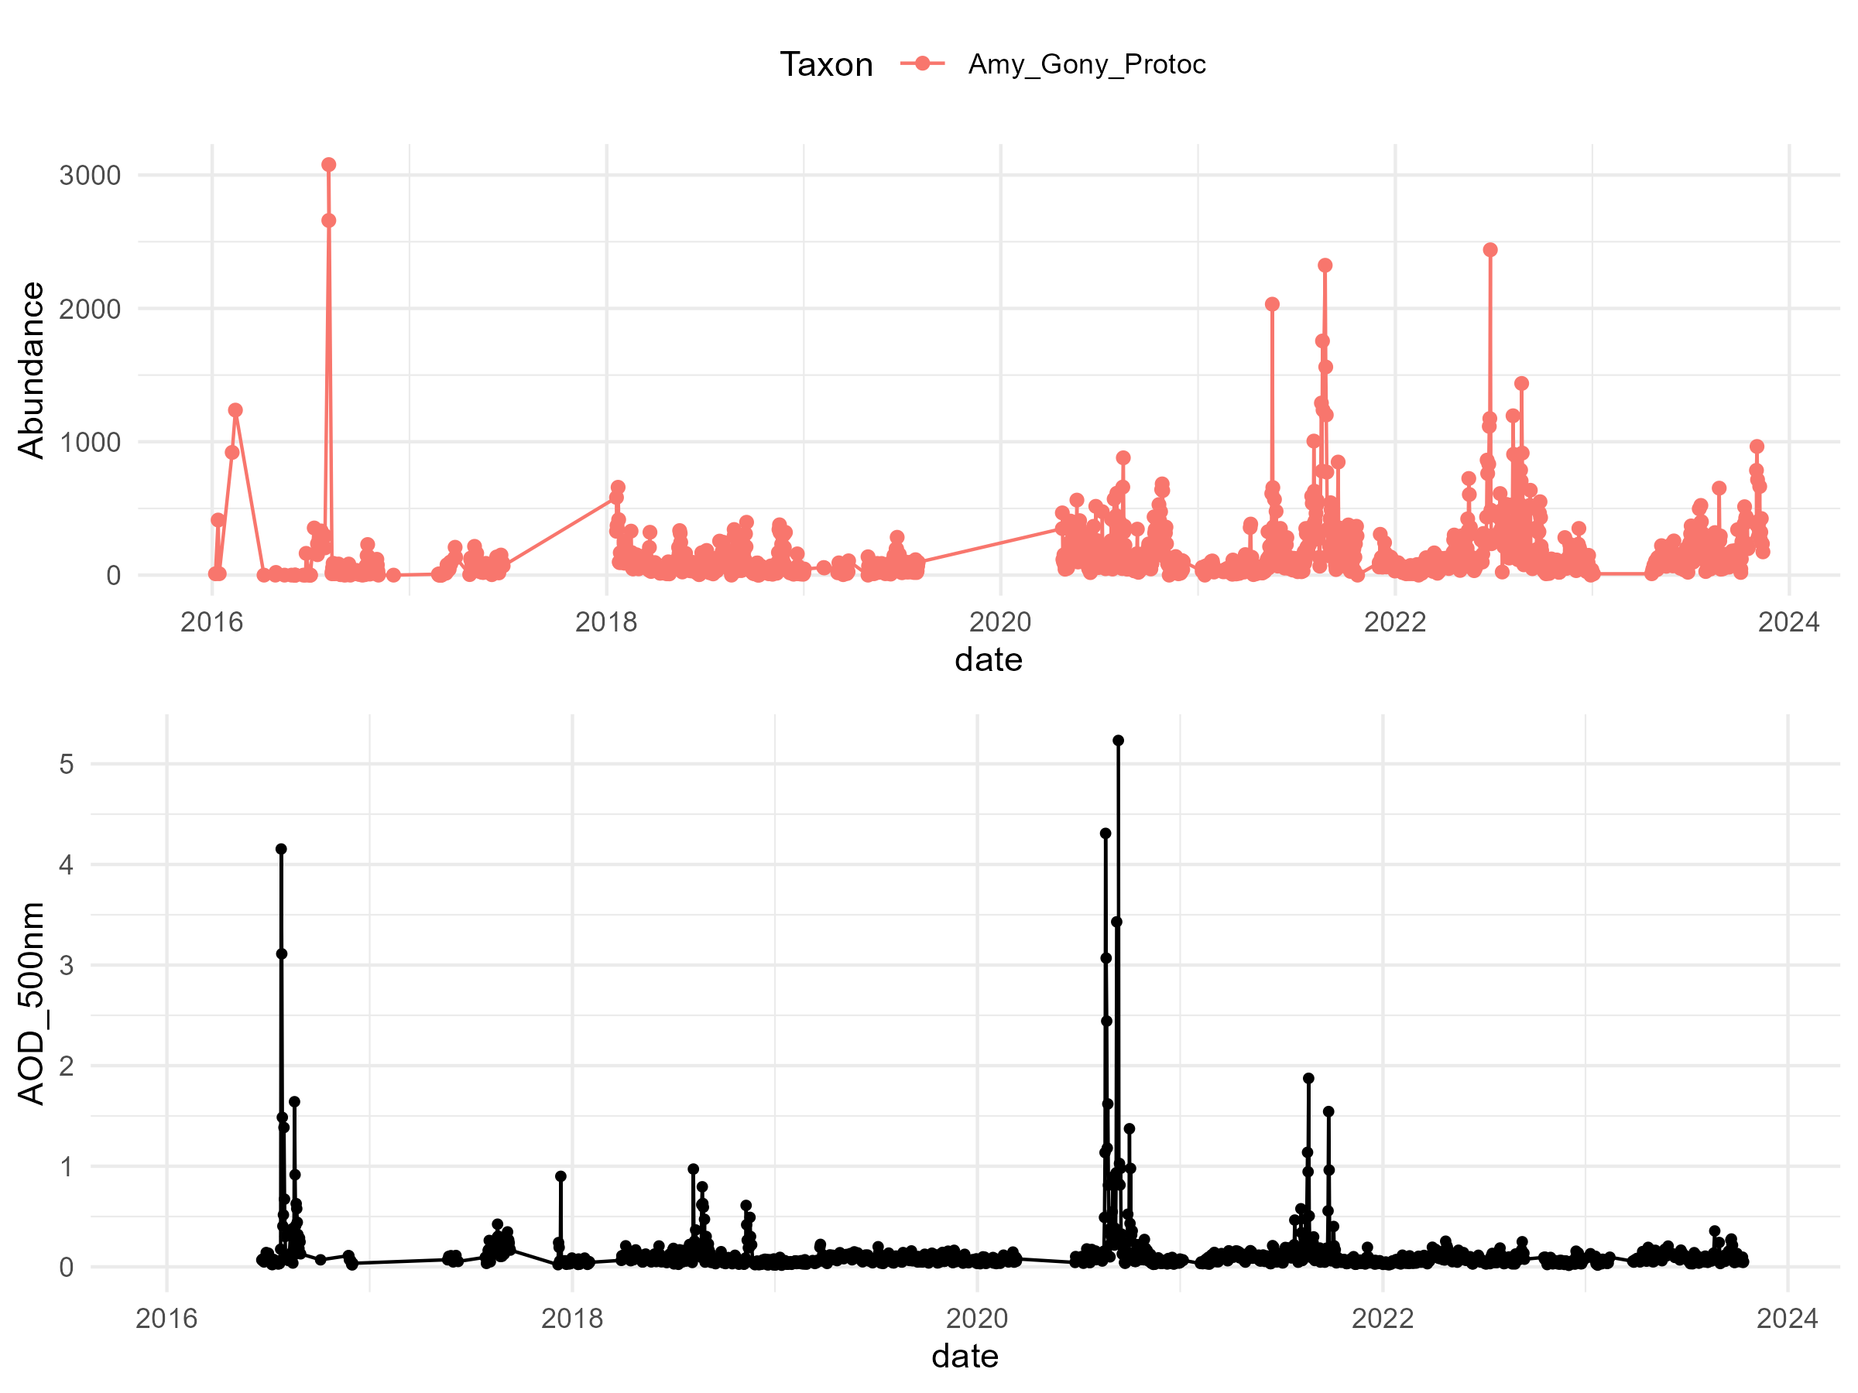
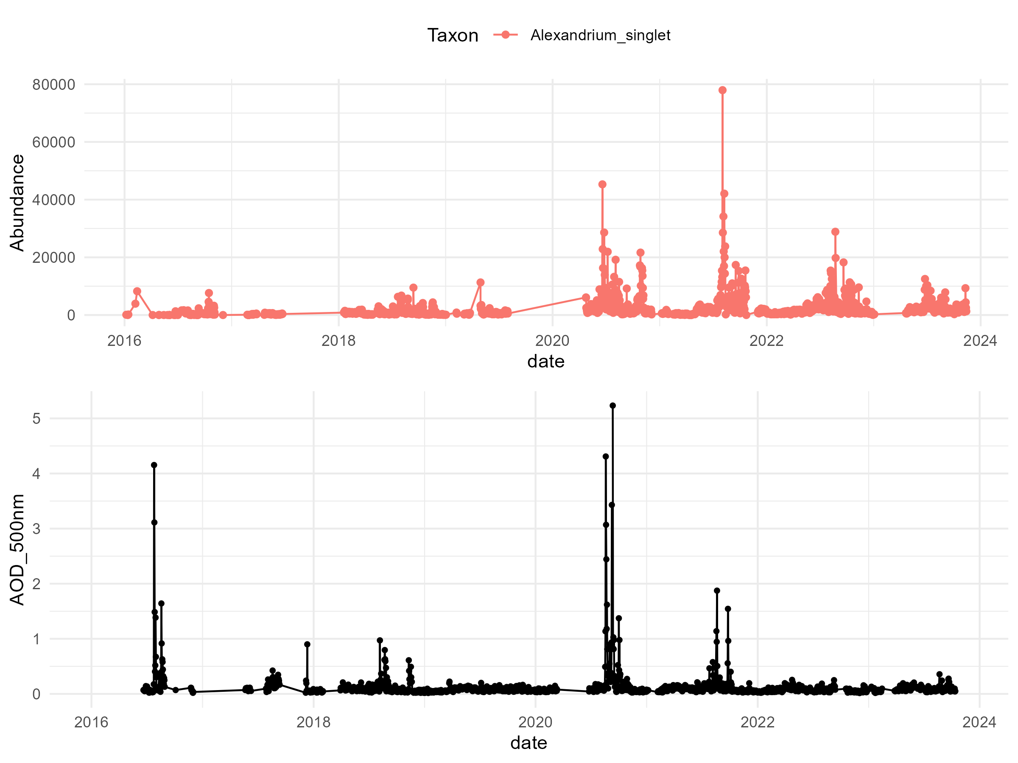
Taxa vs AOD
= potential response

Slide 9
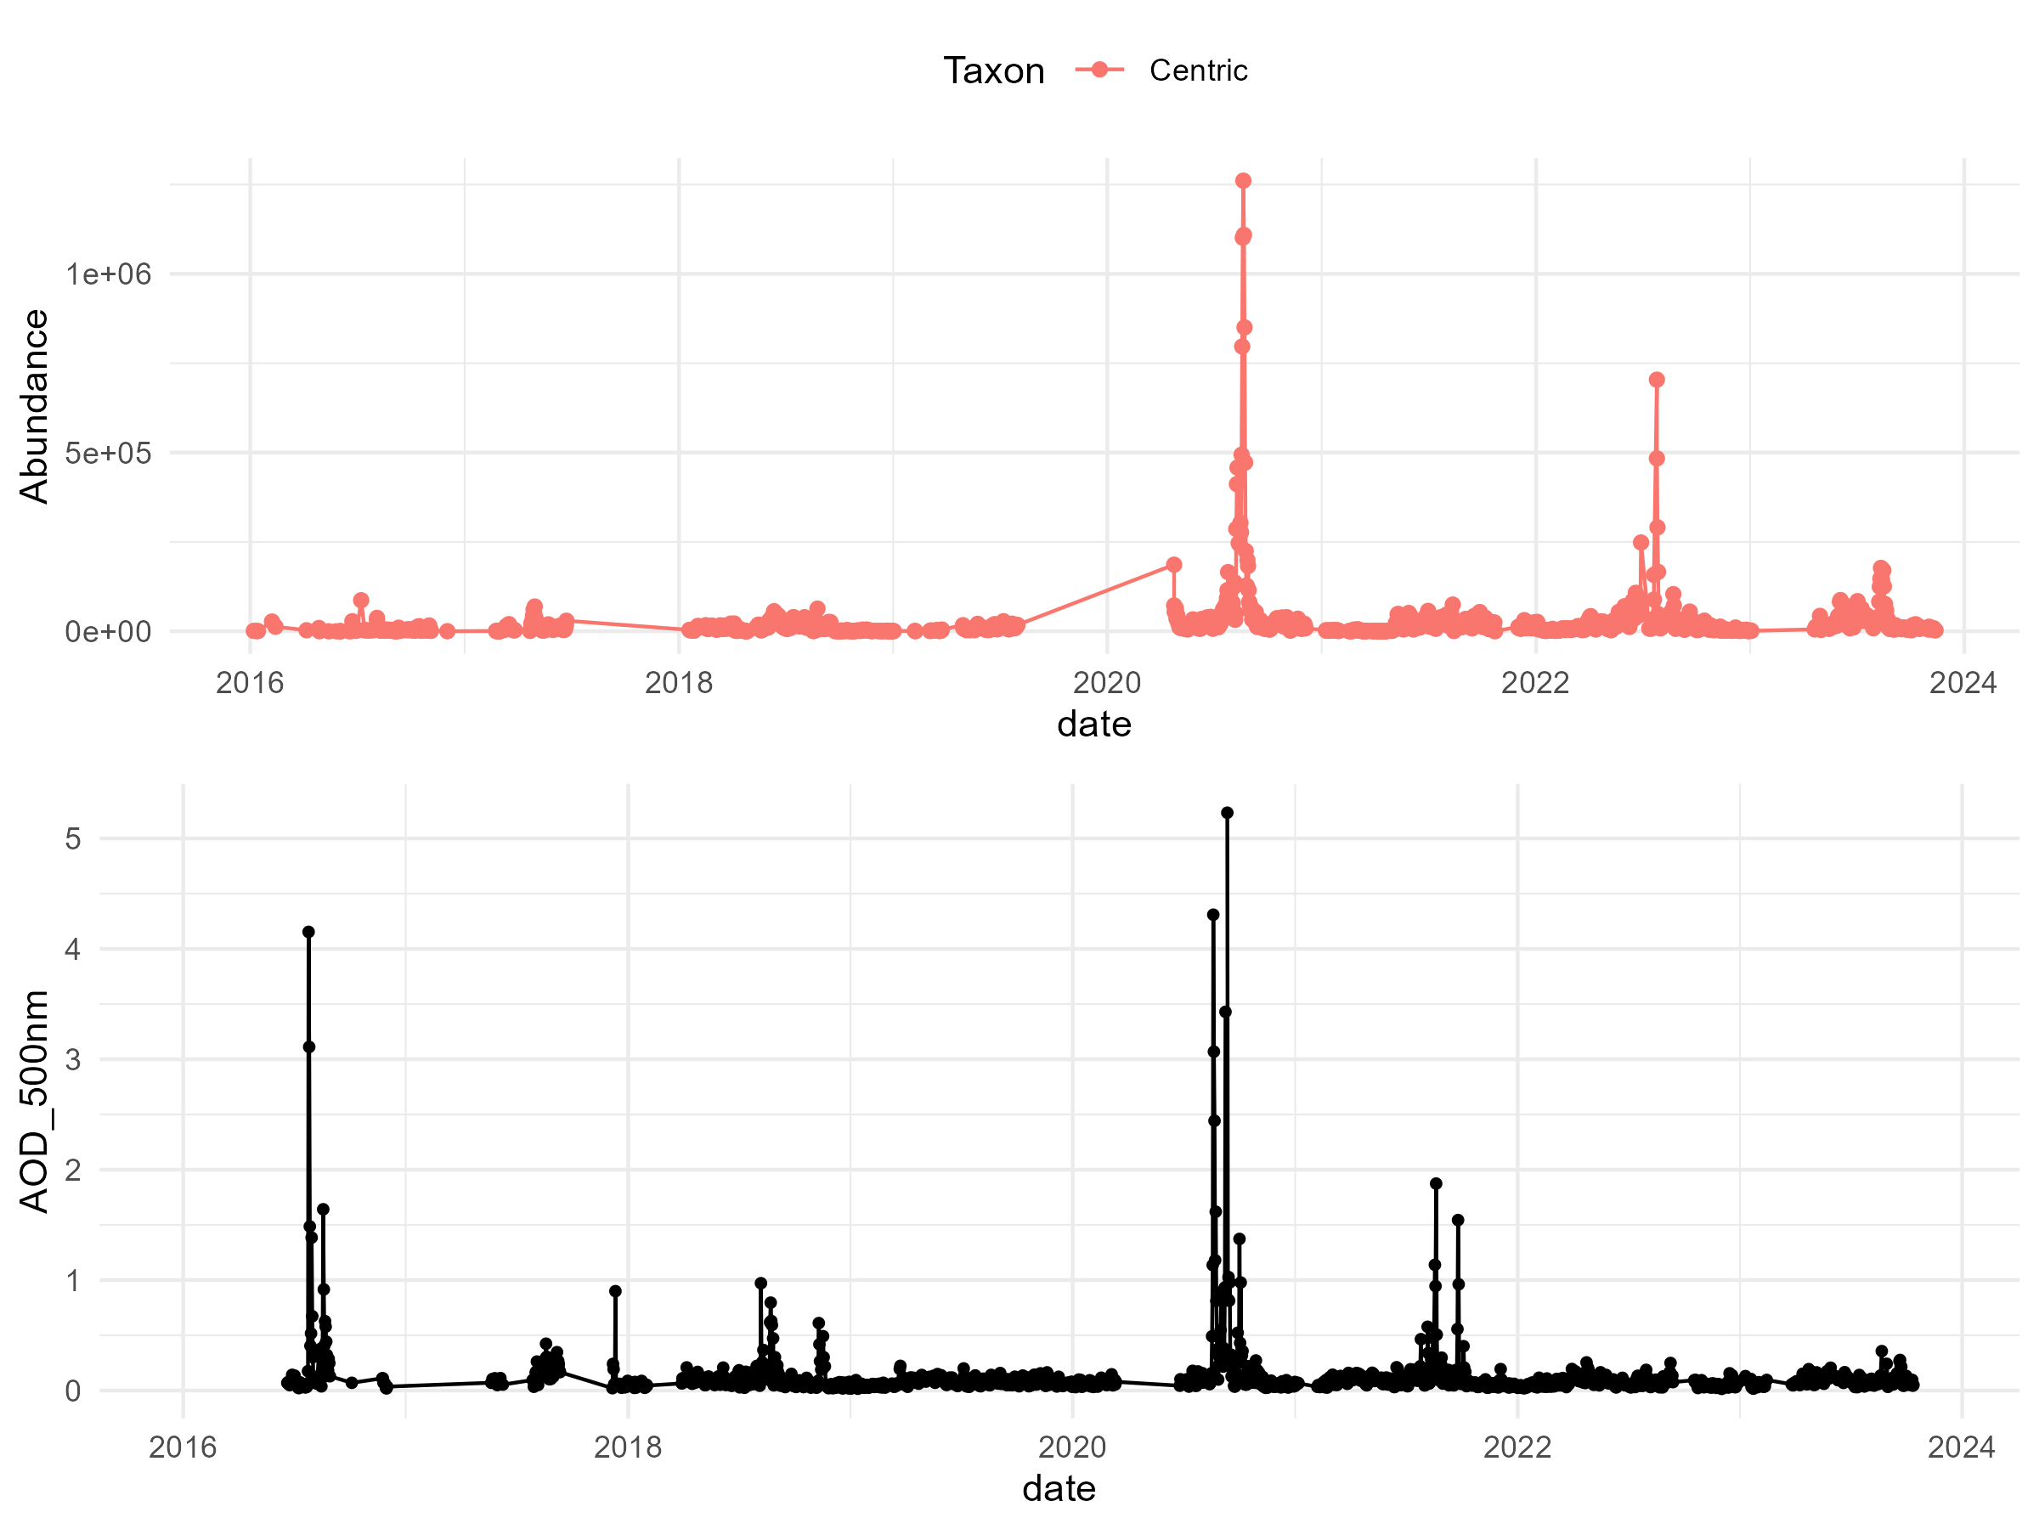
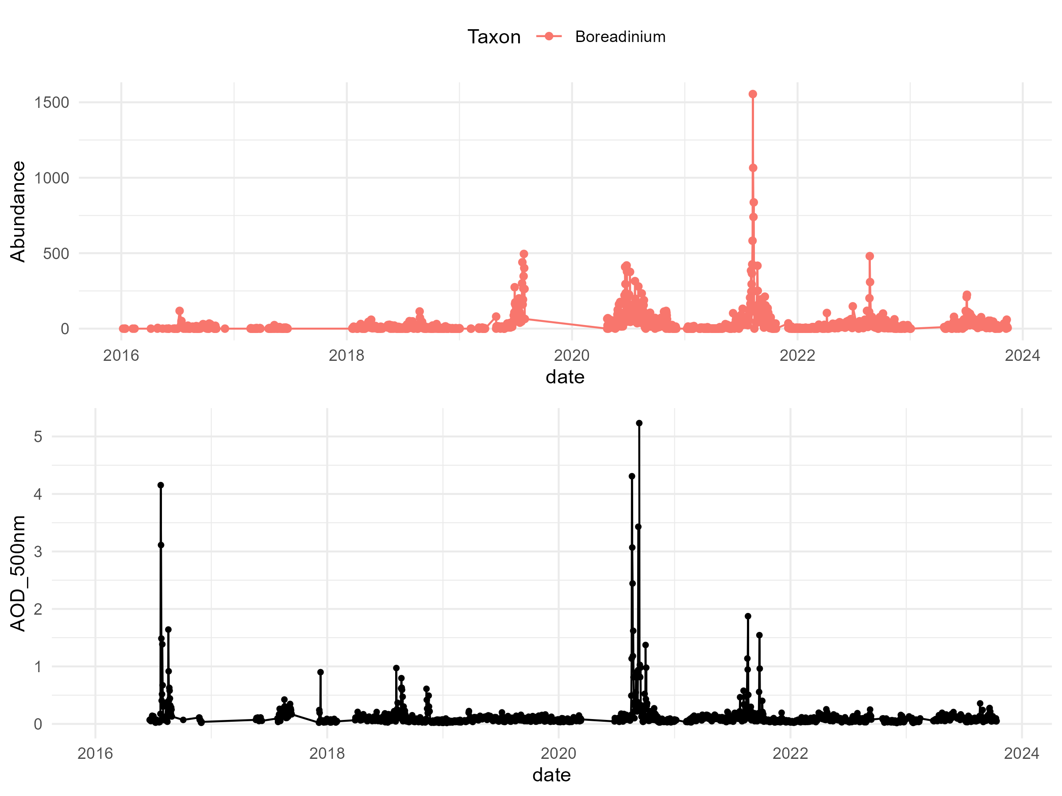
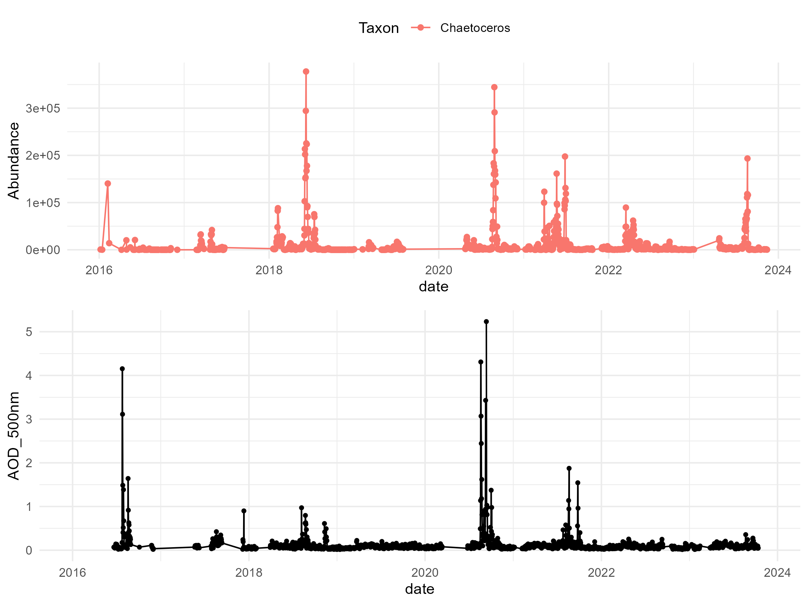
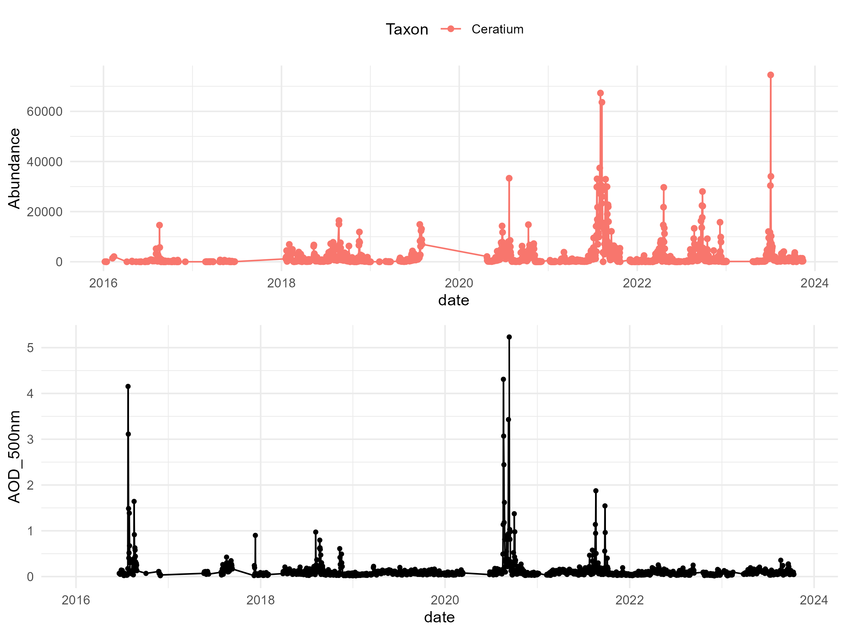
Taxa vs AOD

Slide 10
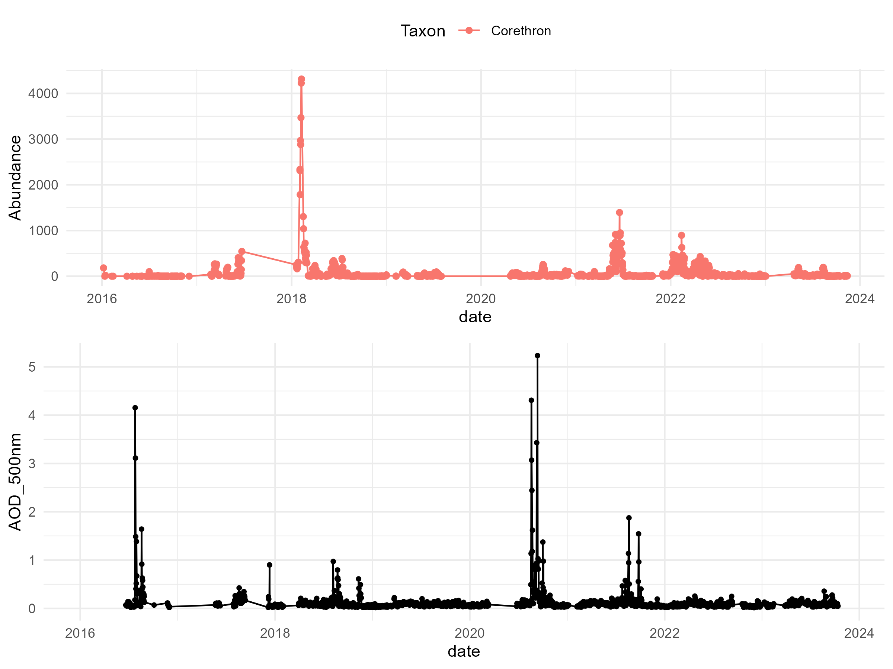
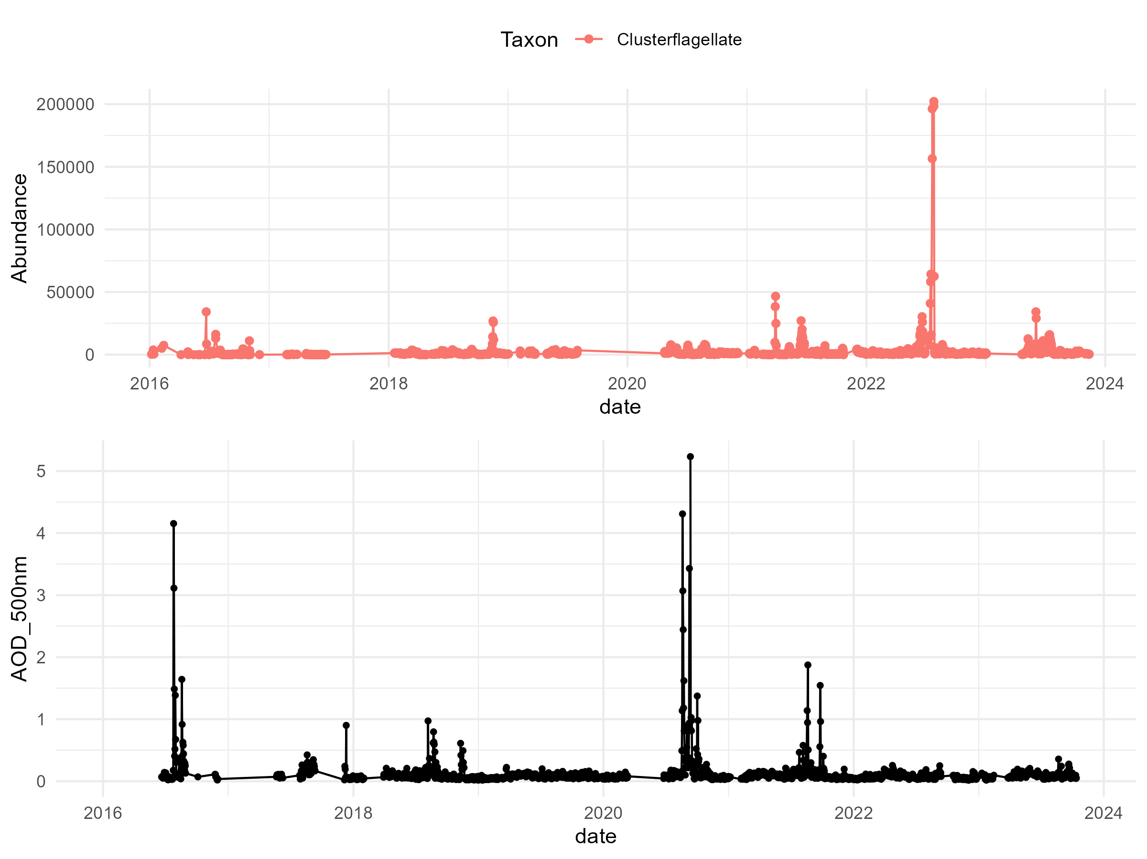
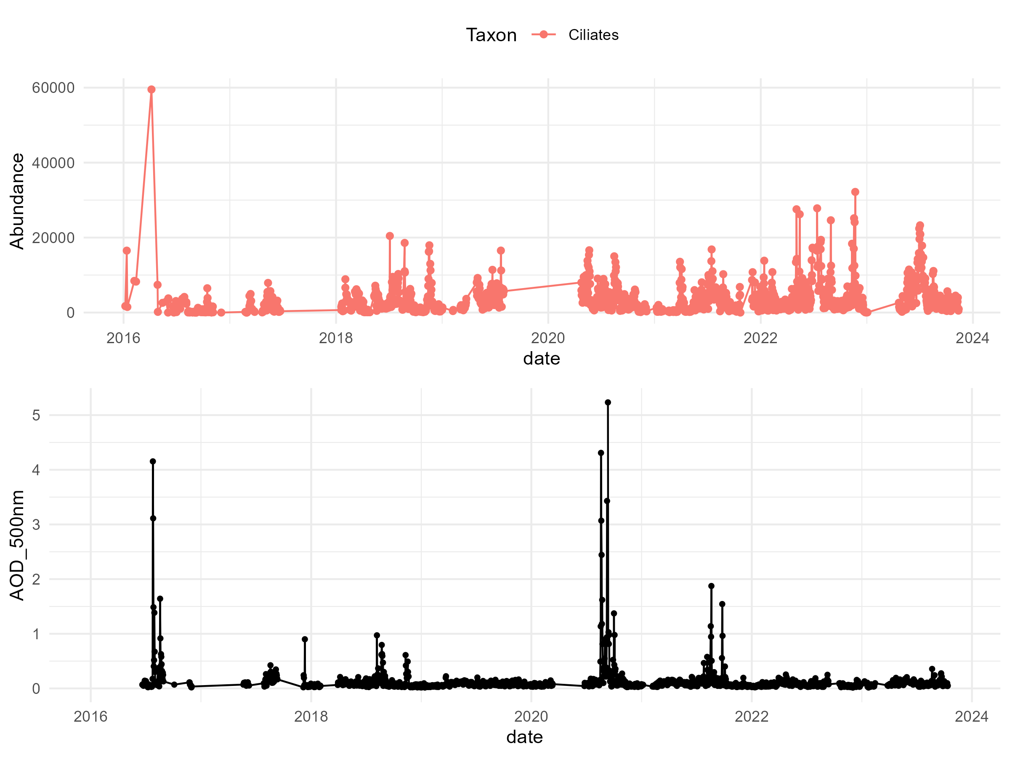
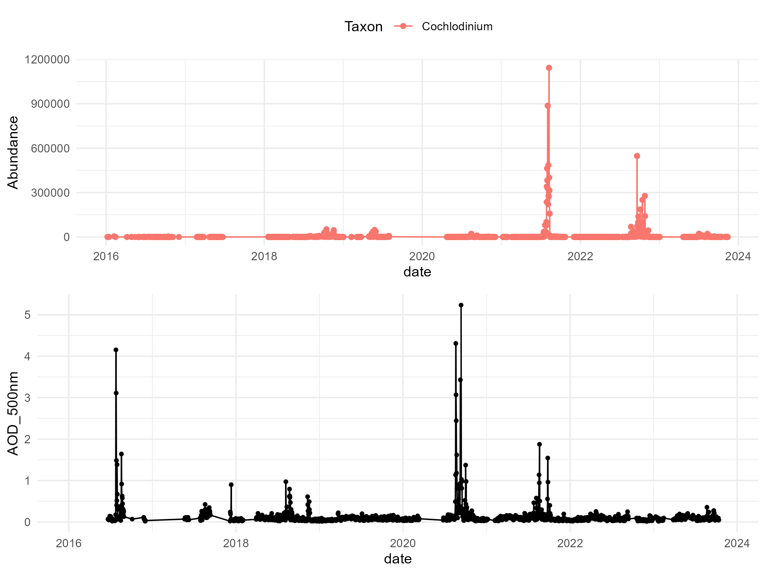
Taxa vs AOD

Slide 11
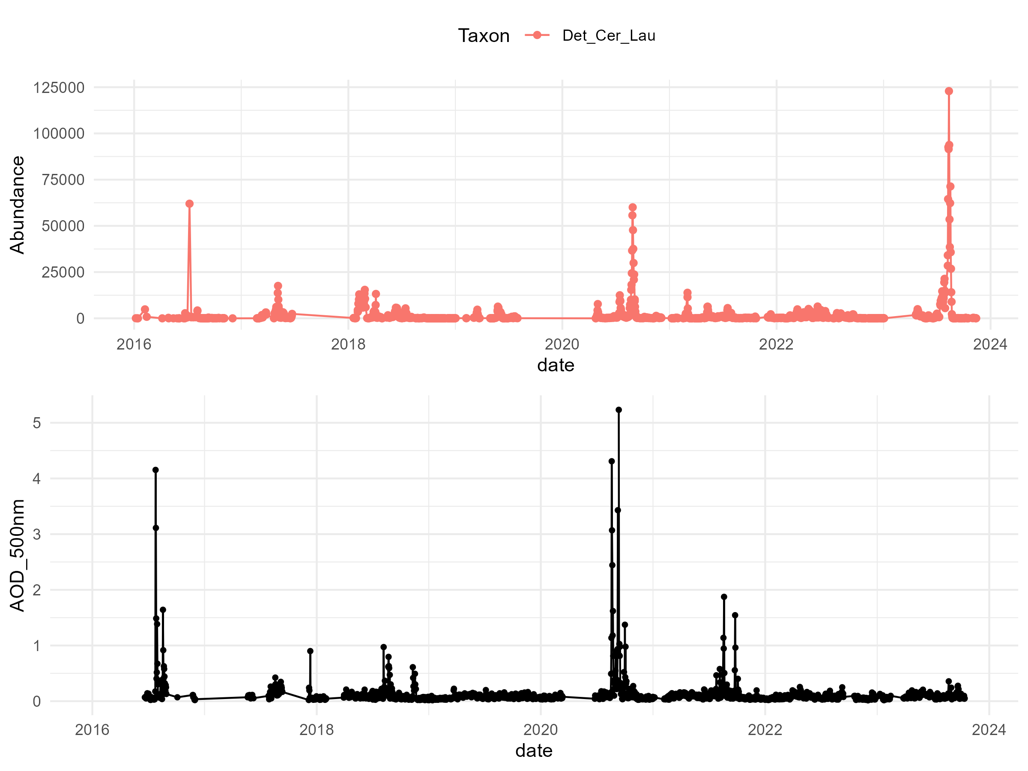
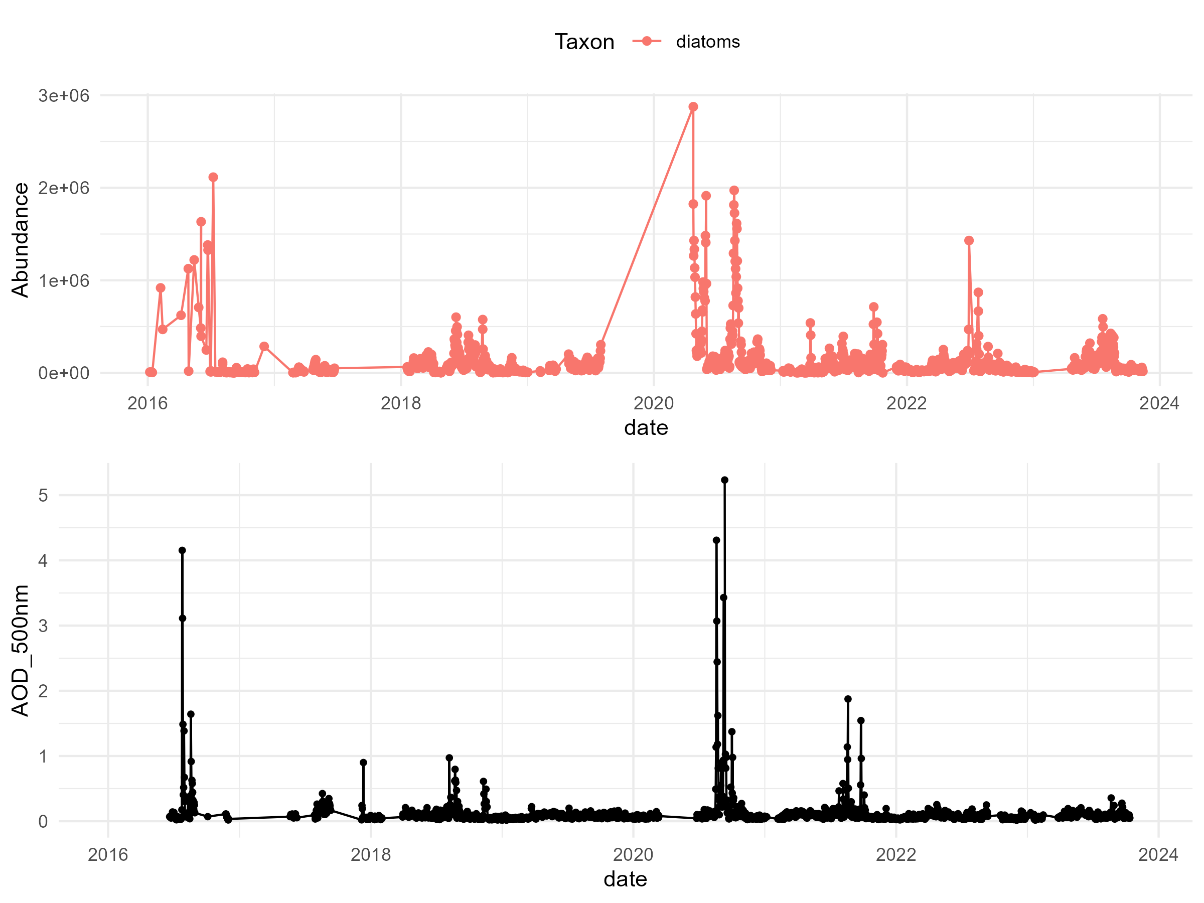
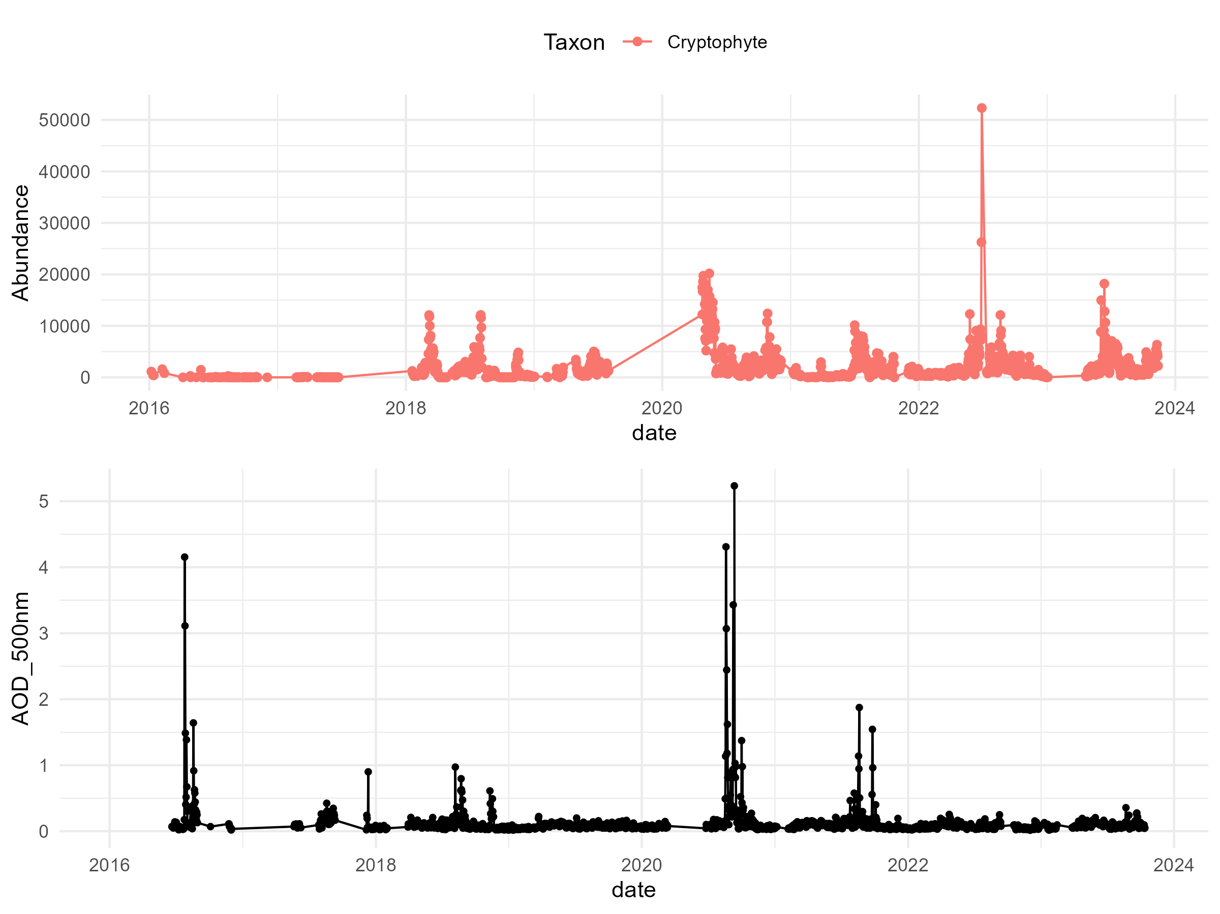
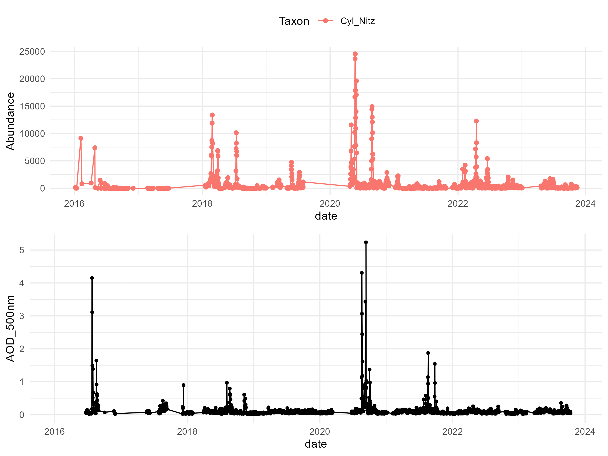
Taxa vs AOD

Slide 12
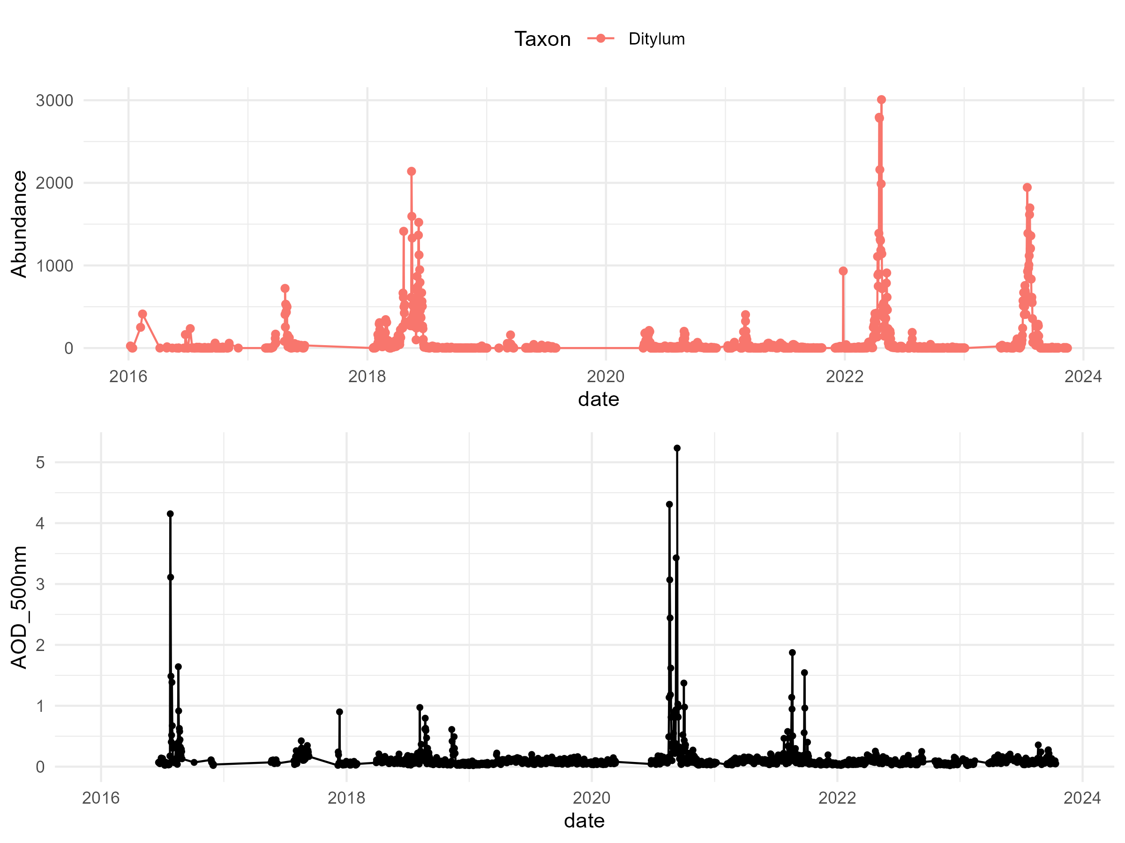
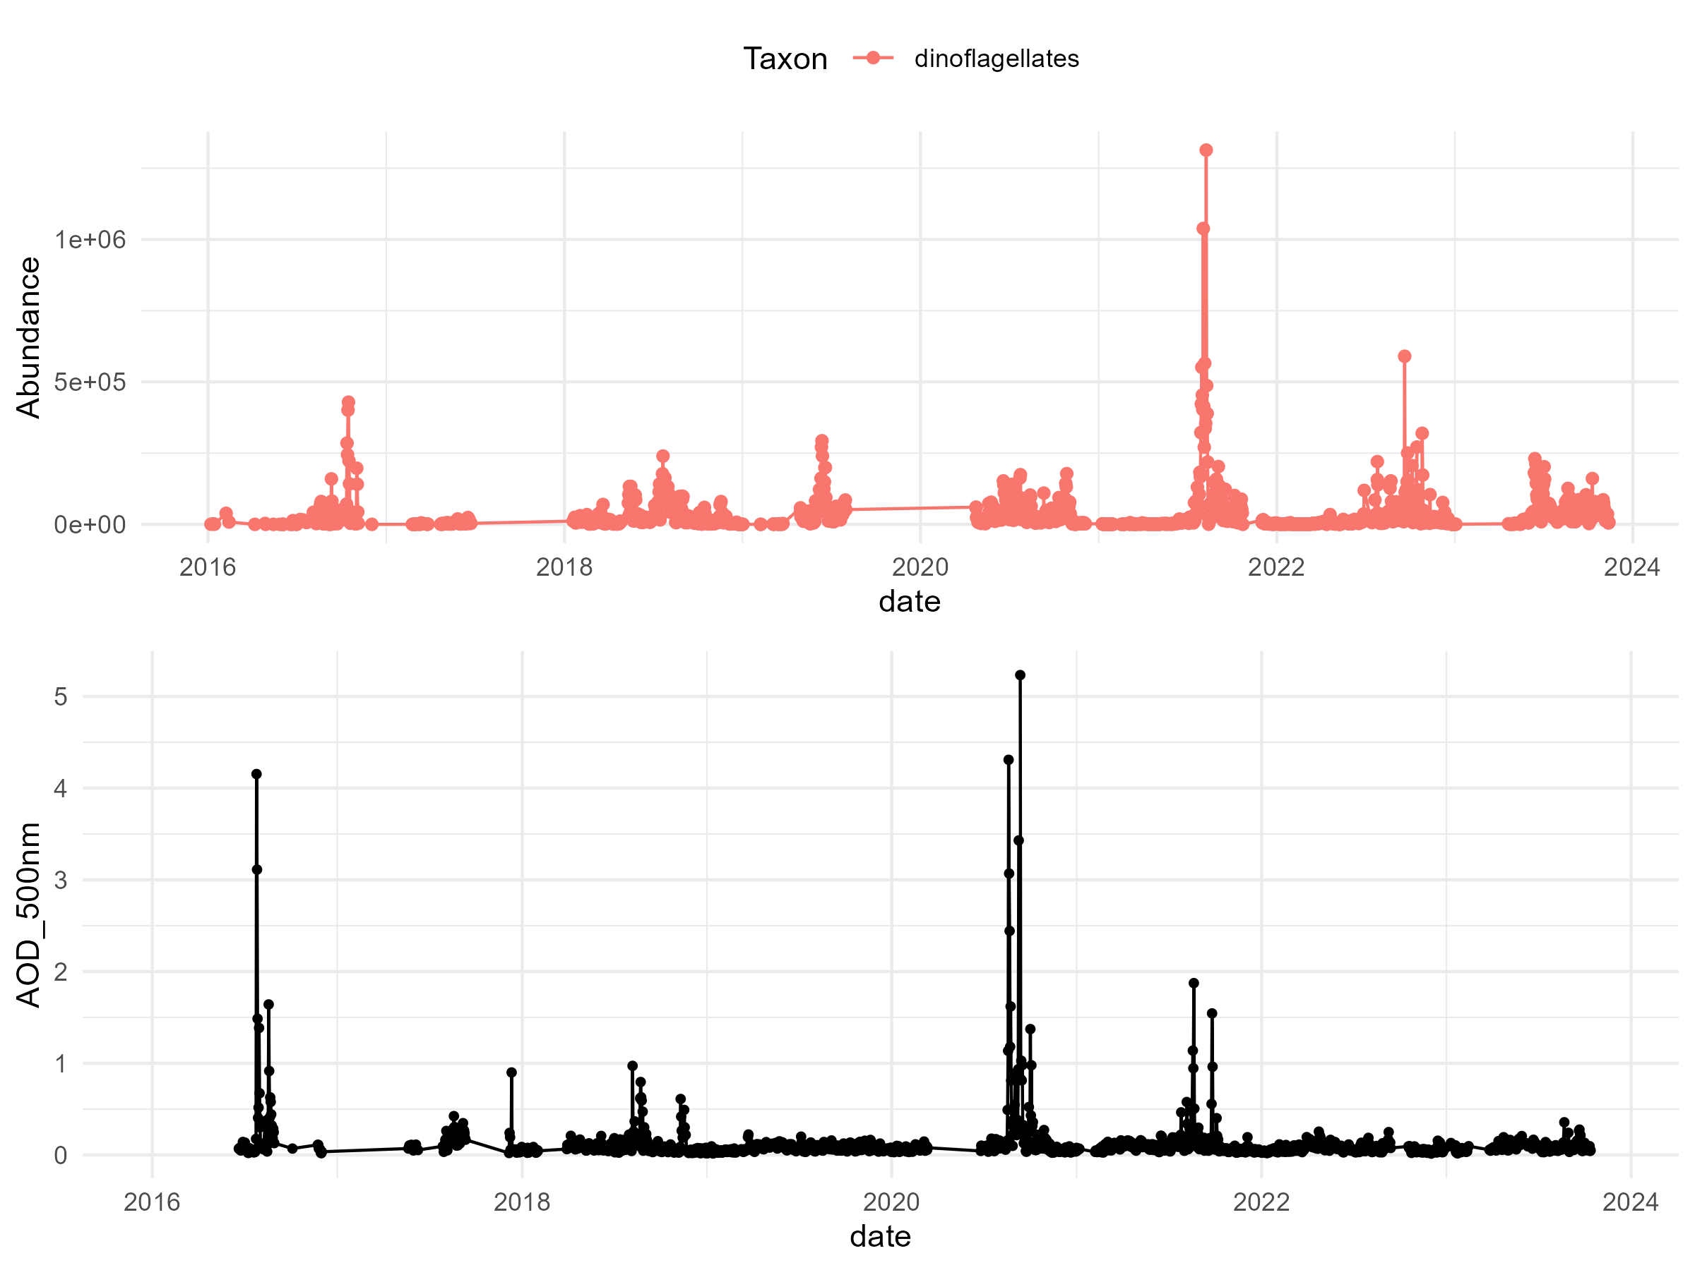
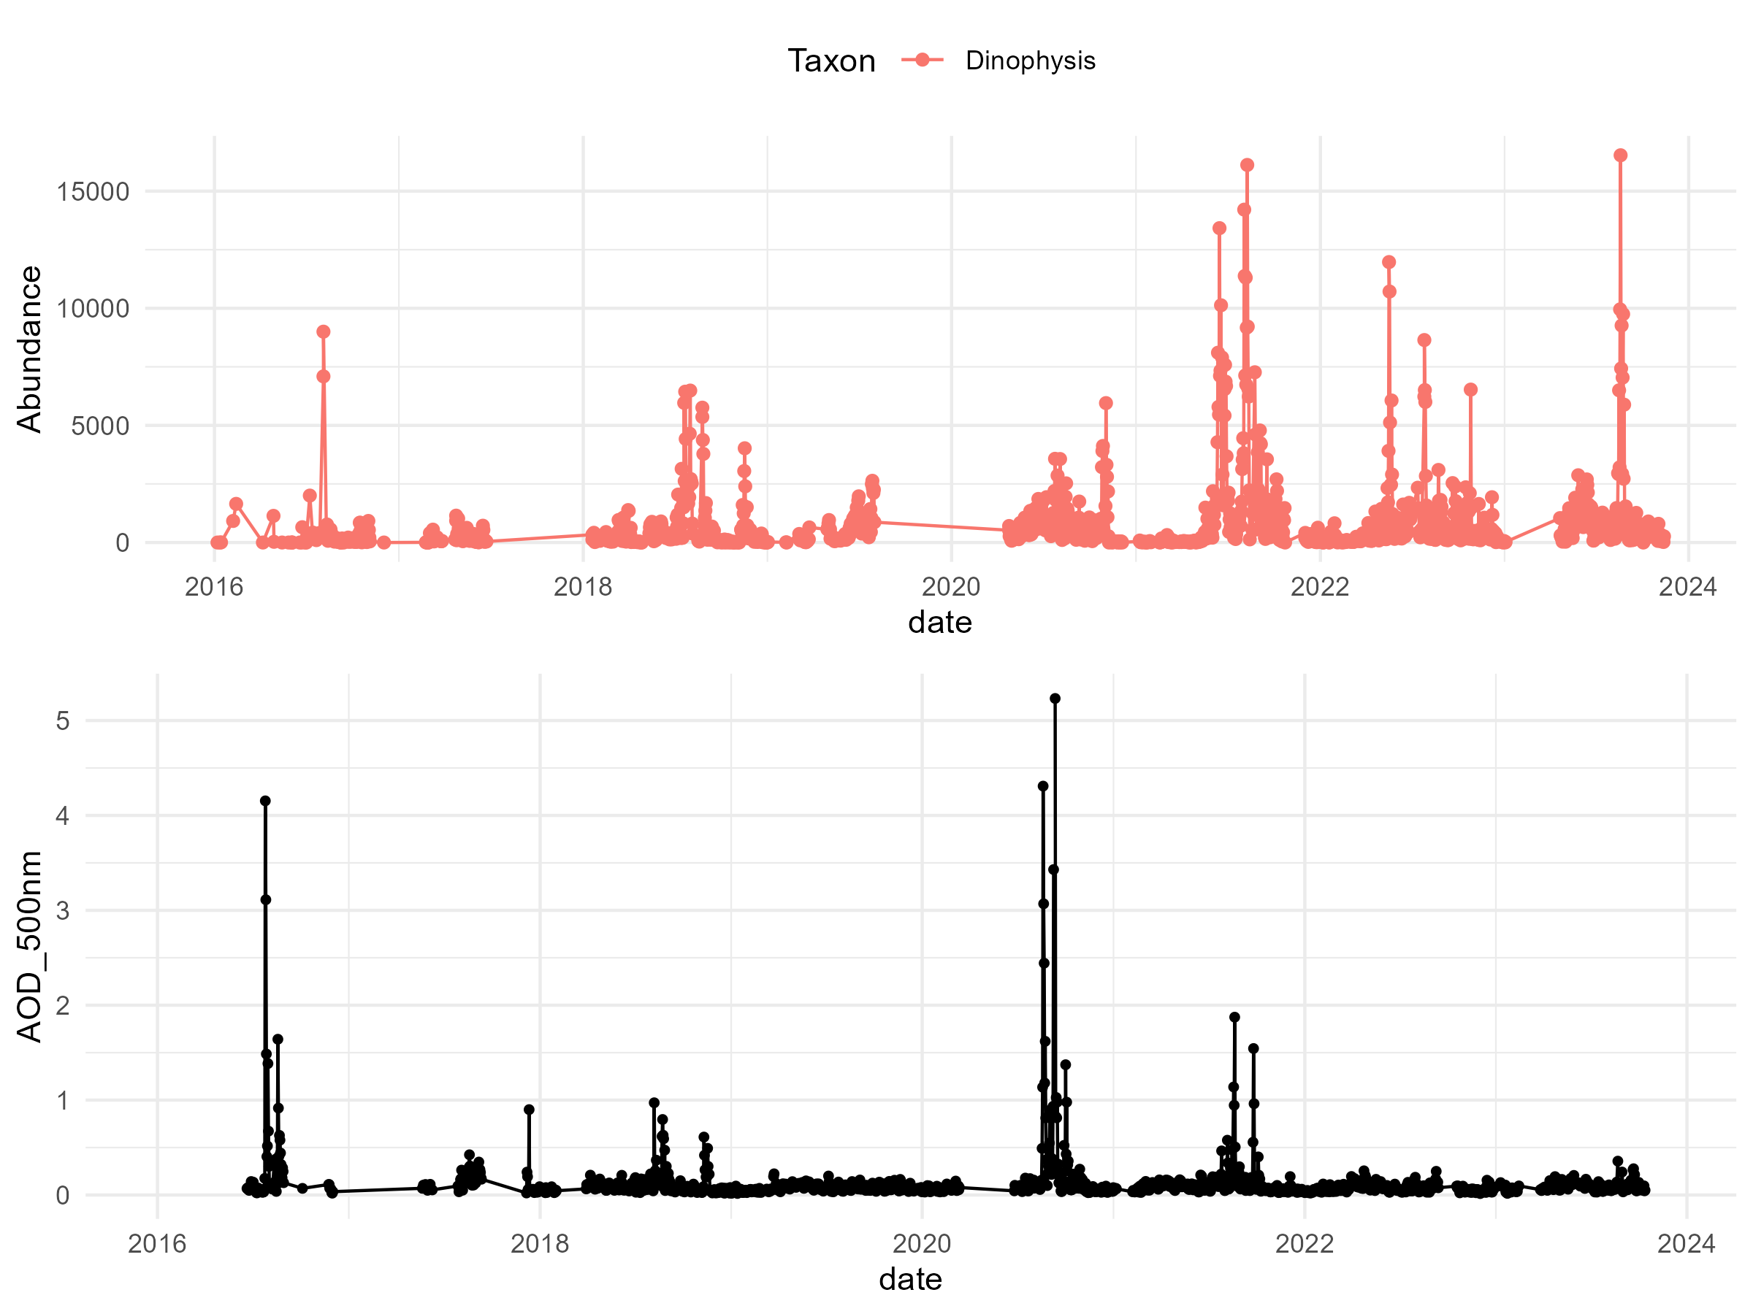
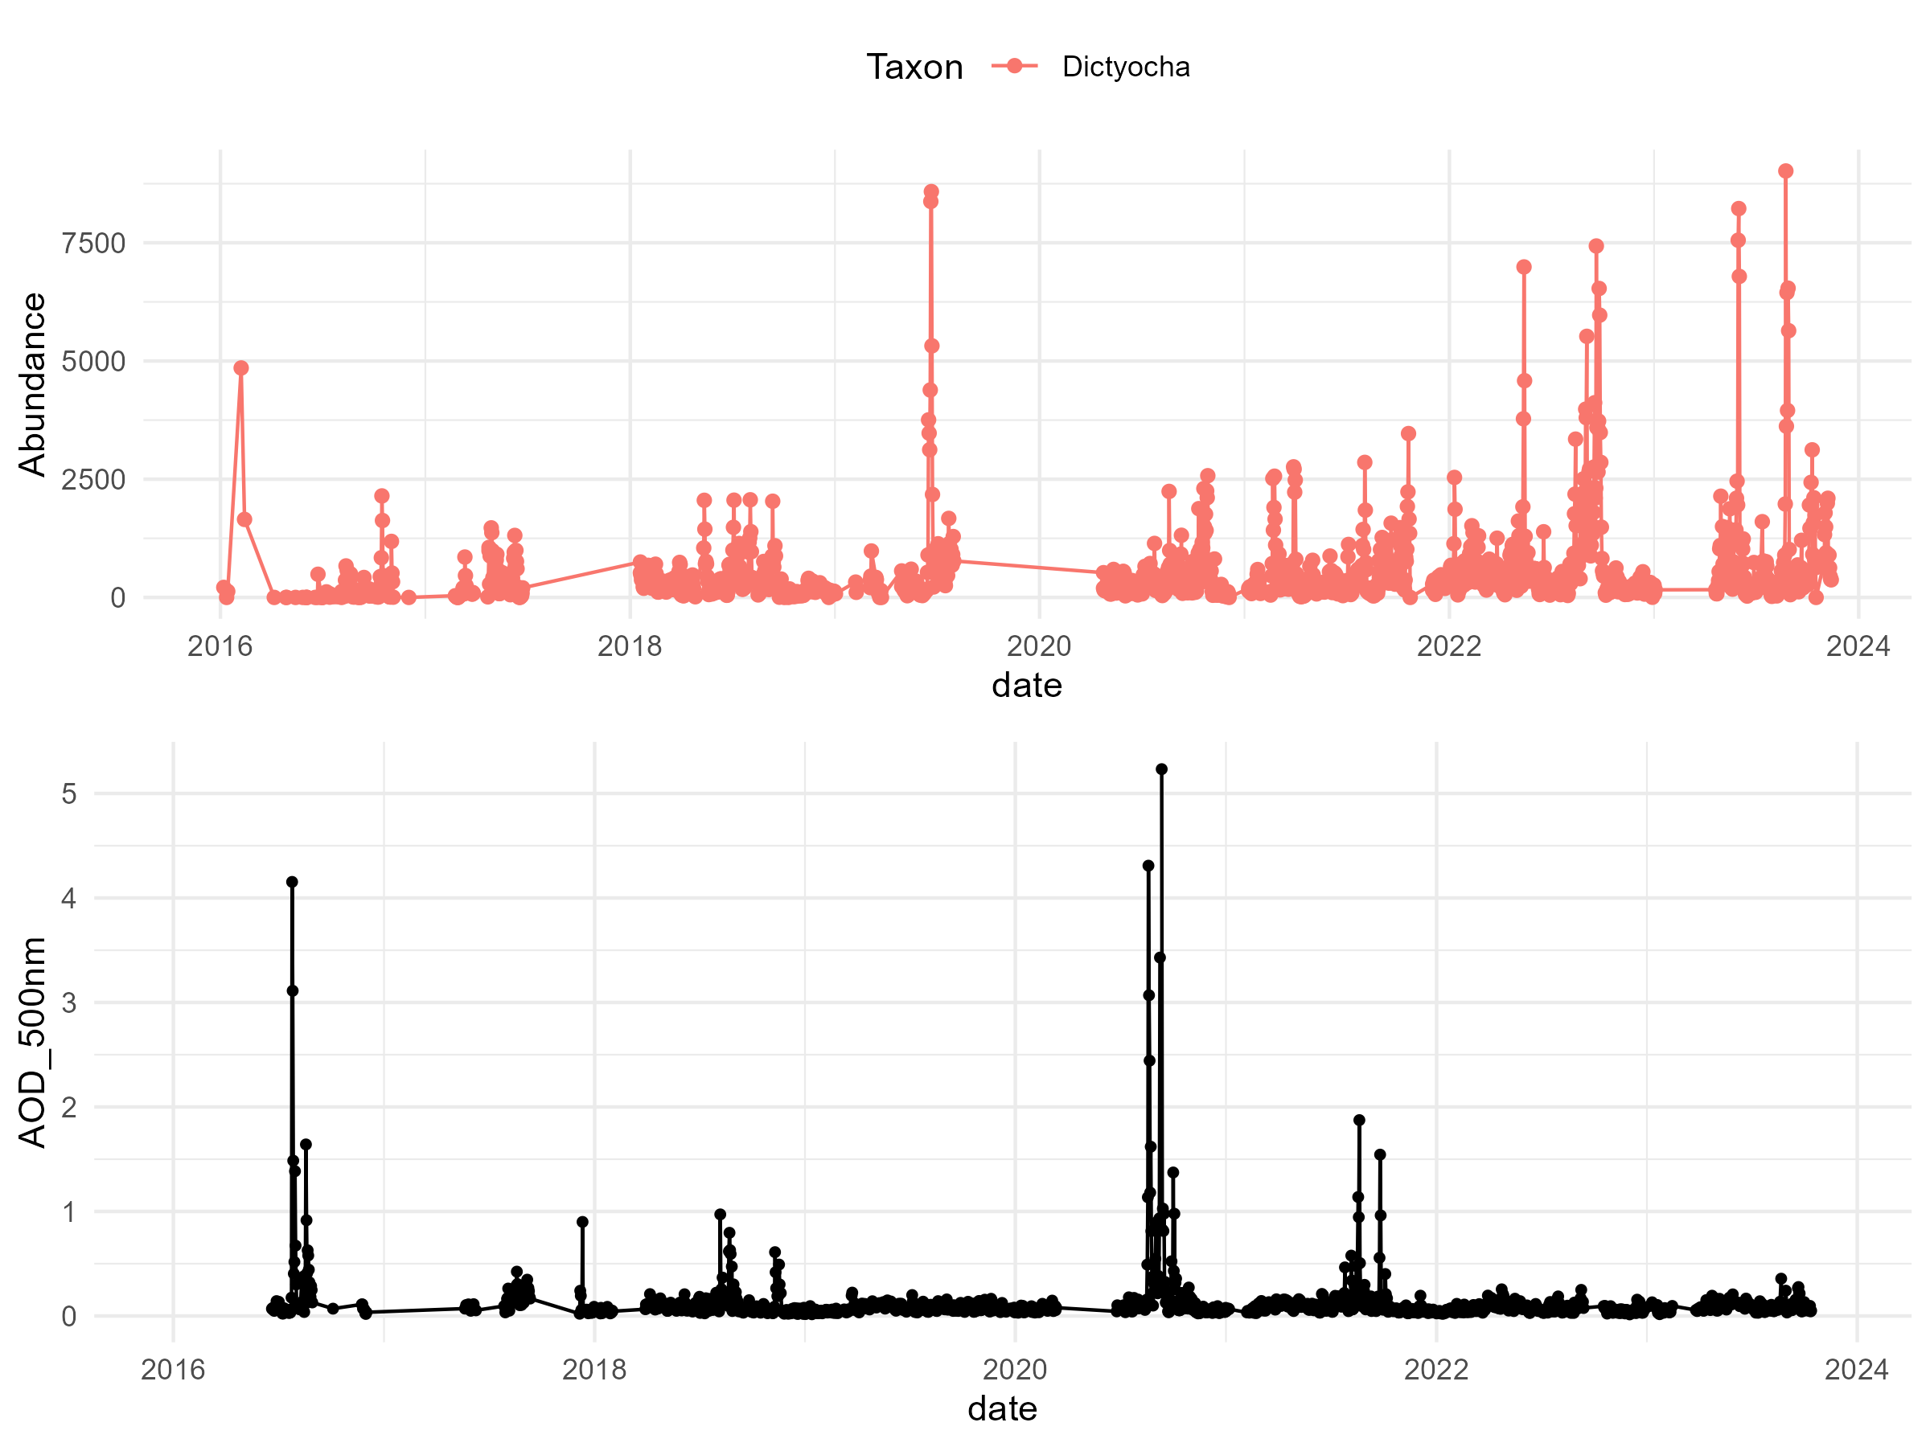
Taxa vs AOD

Slide 13
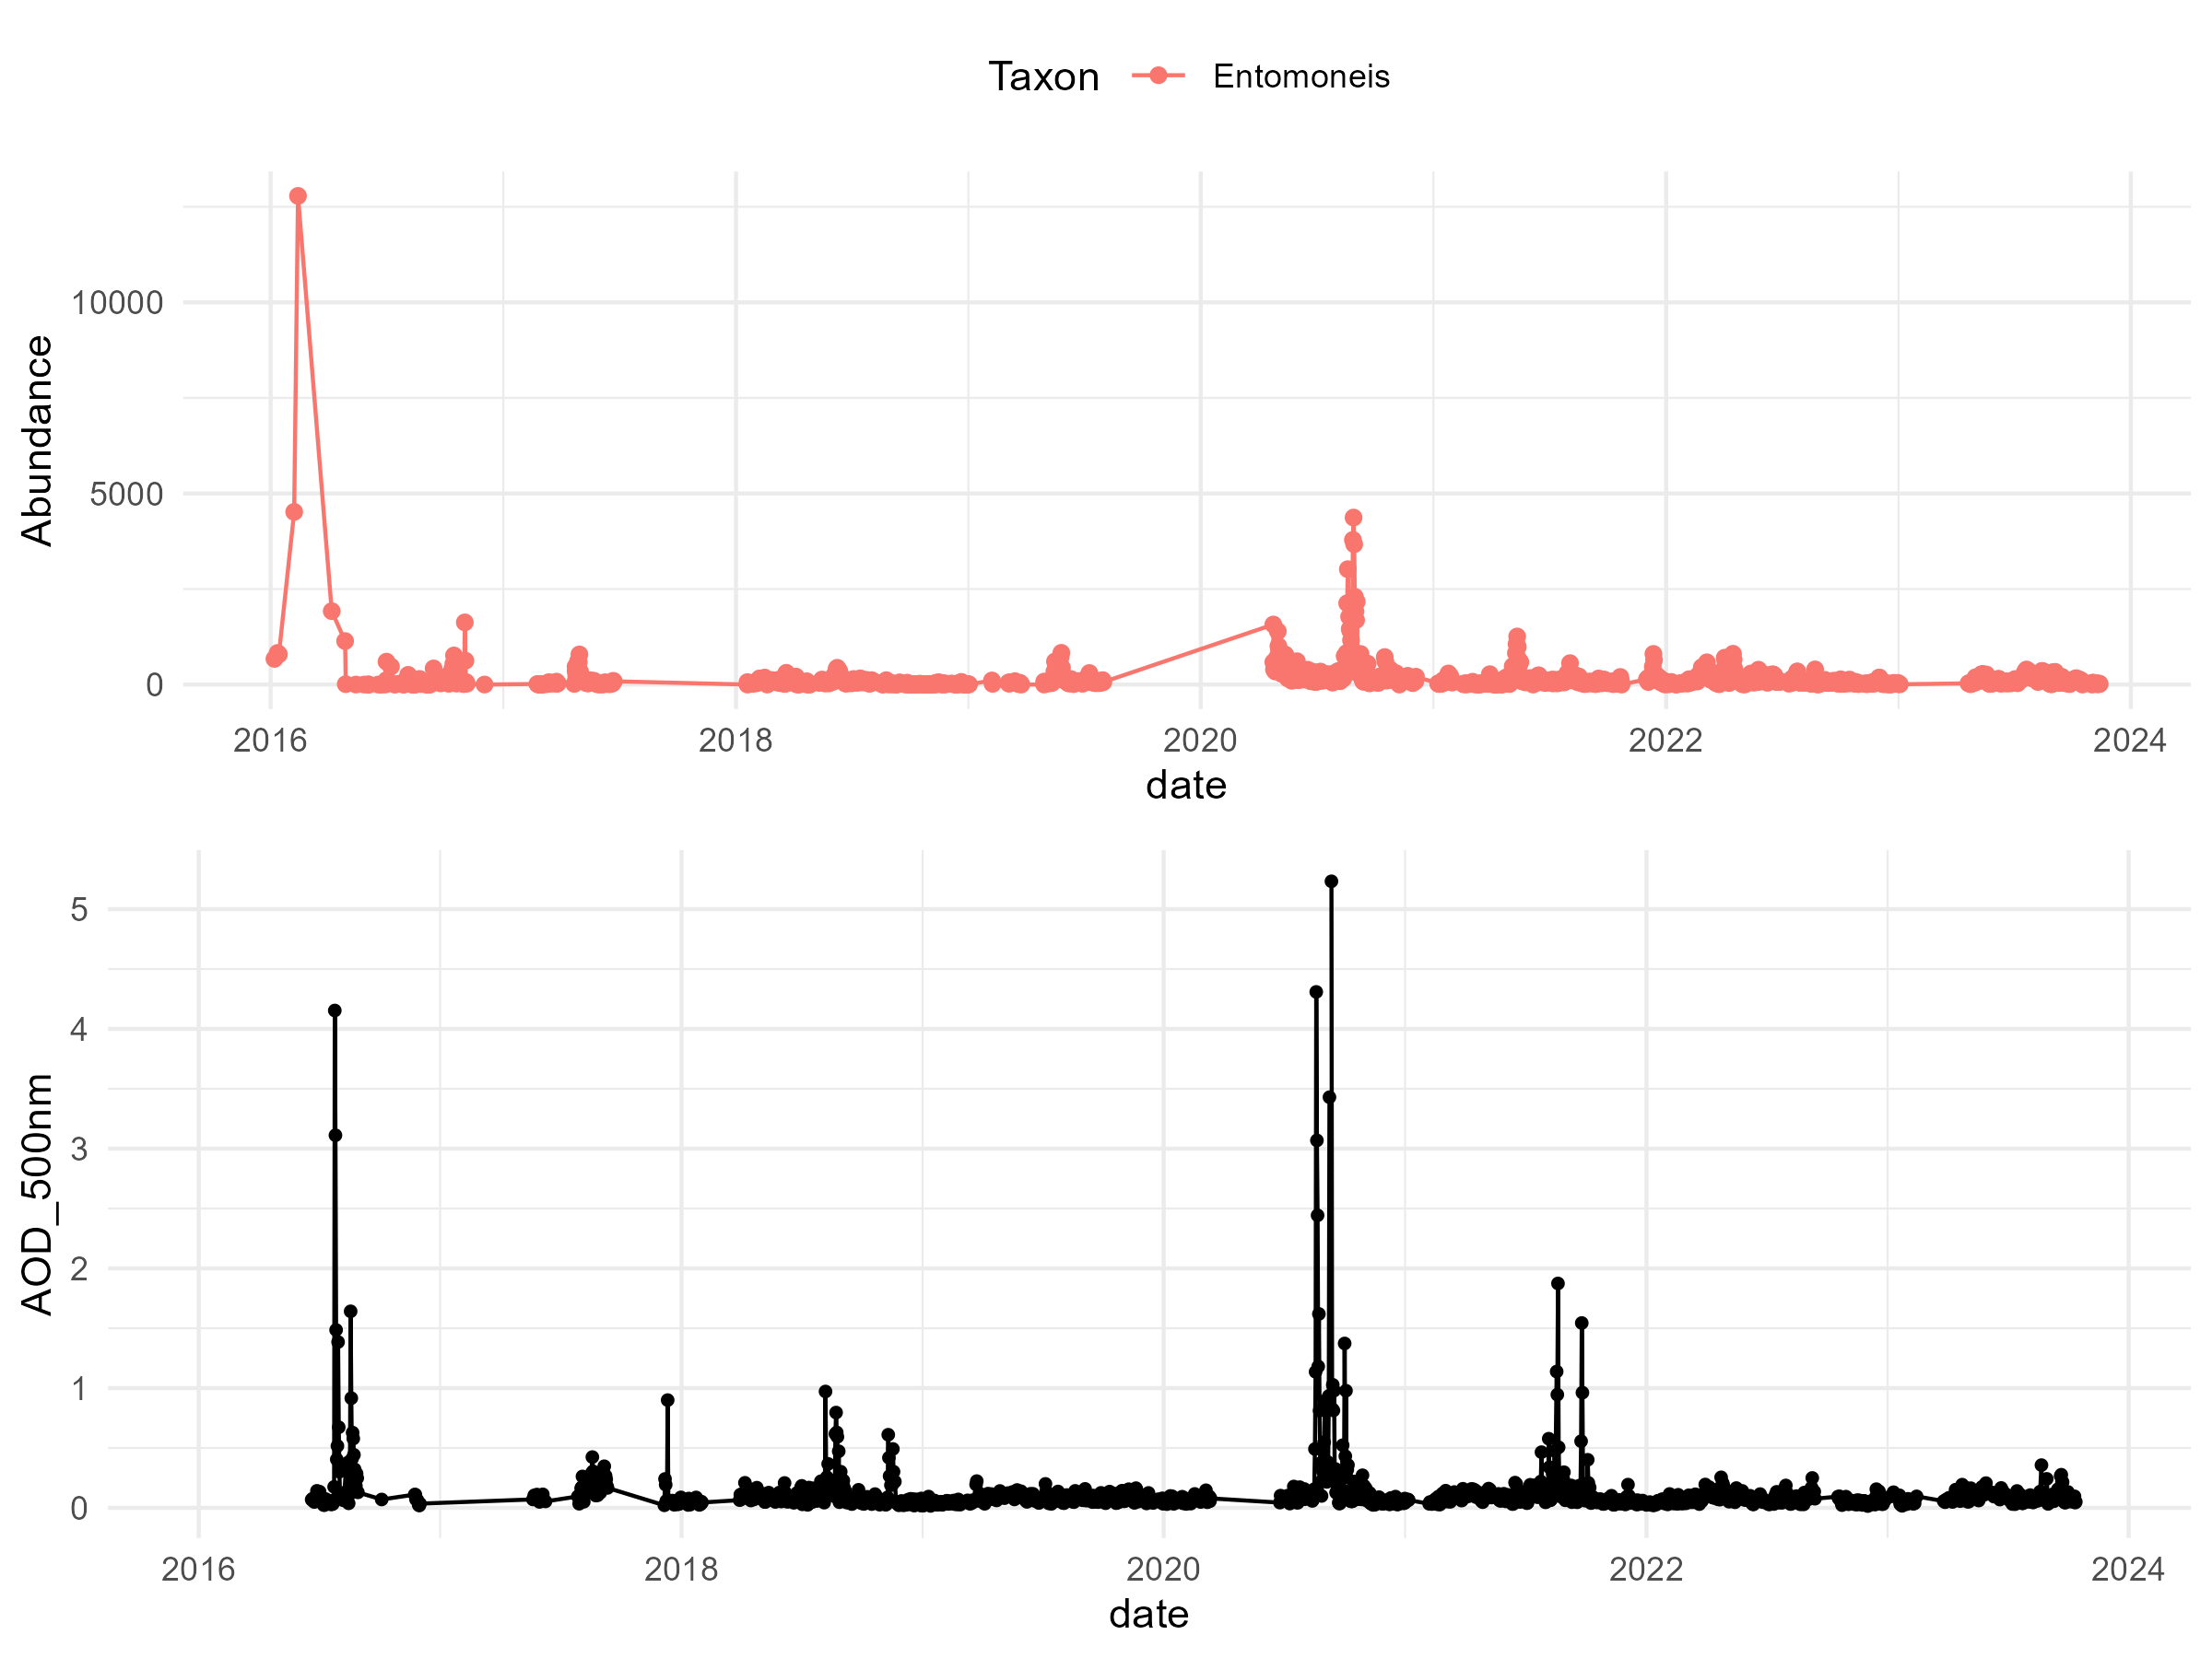
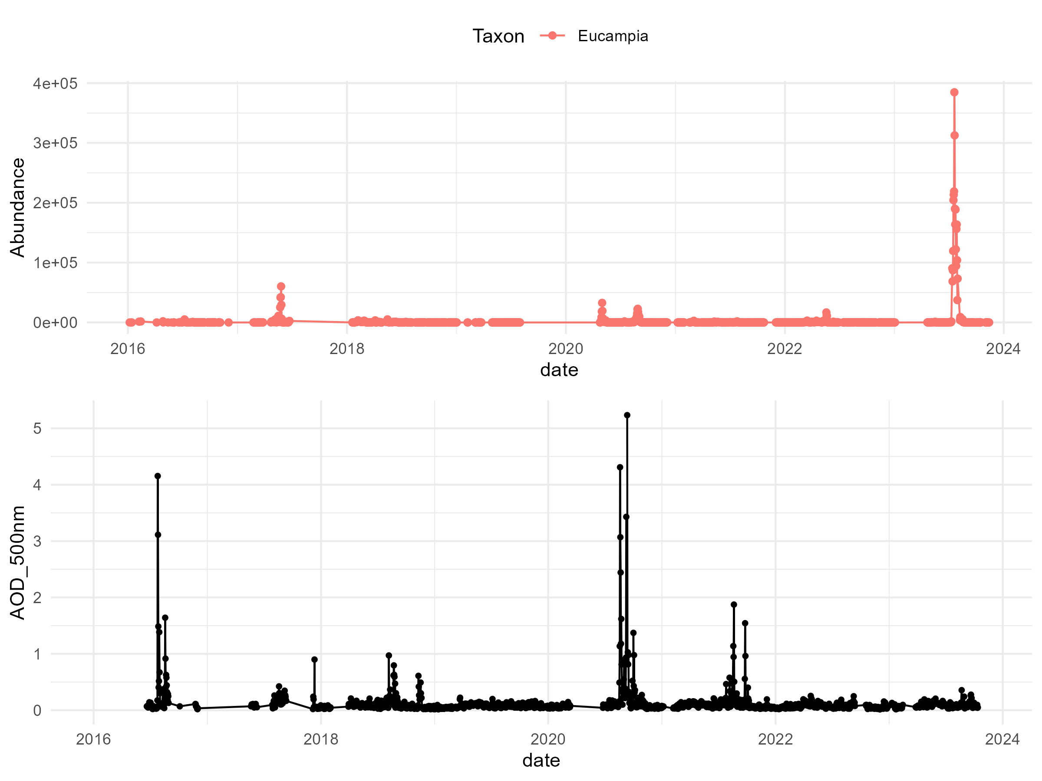
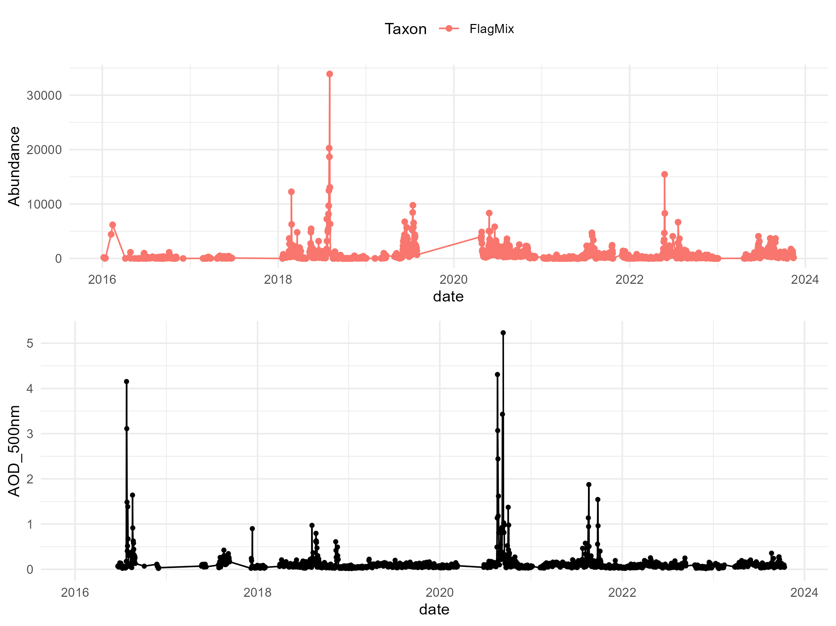
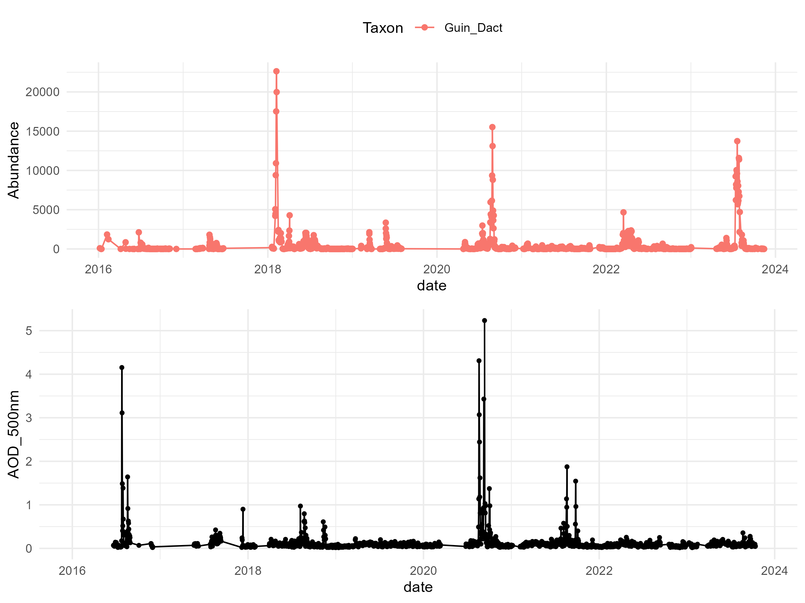
Taxa vs AOD

Slide 14
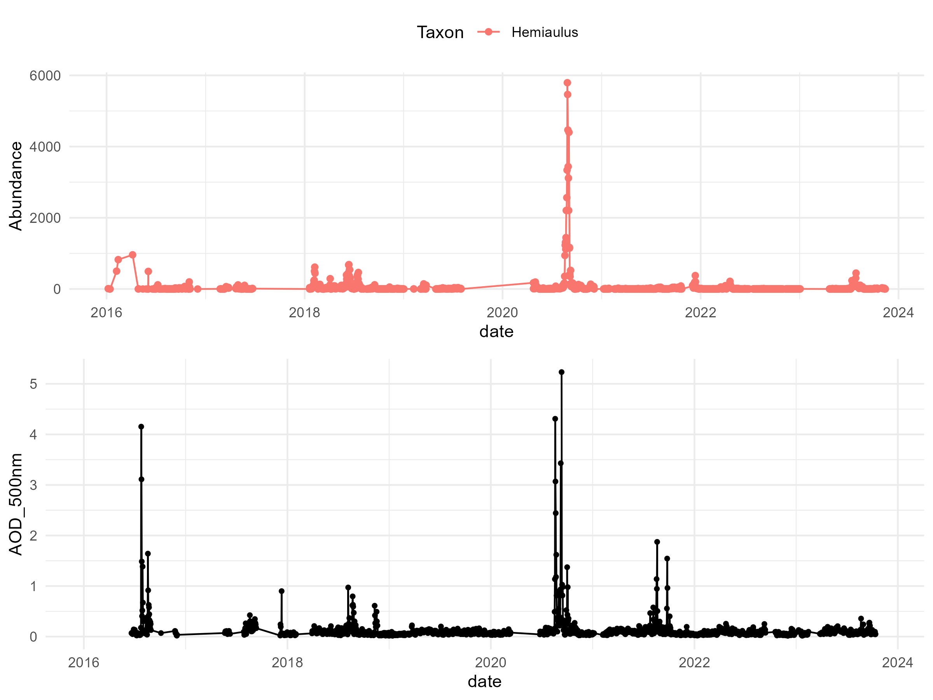
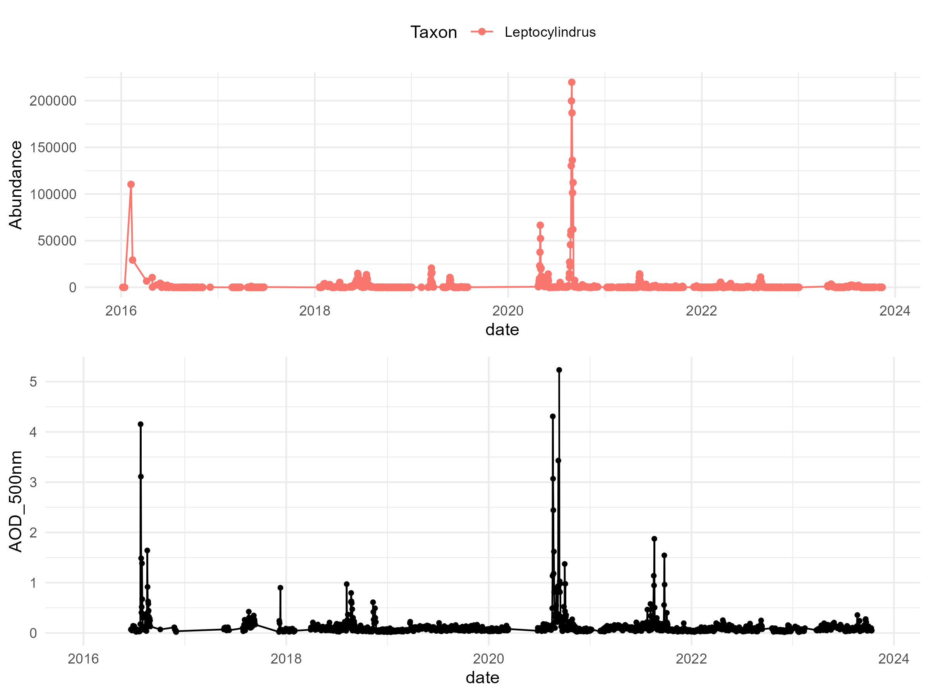
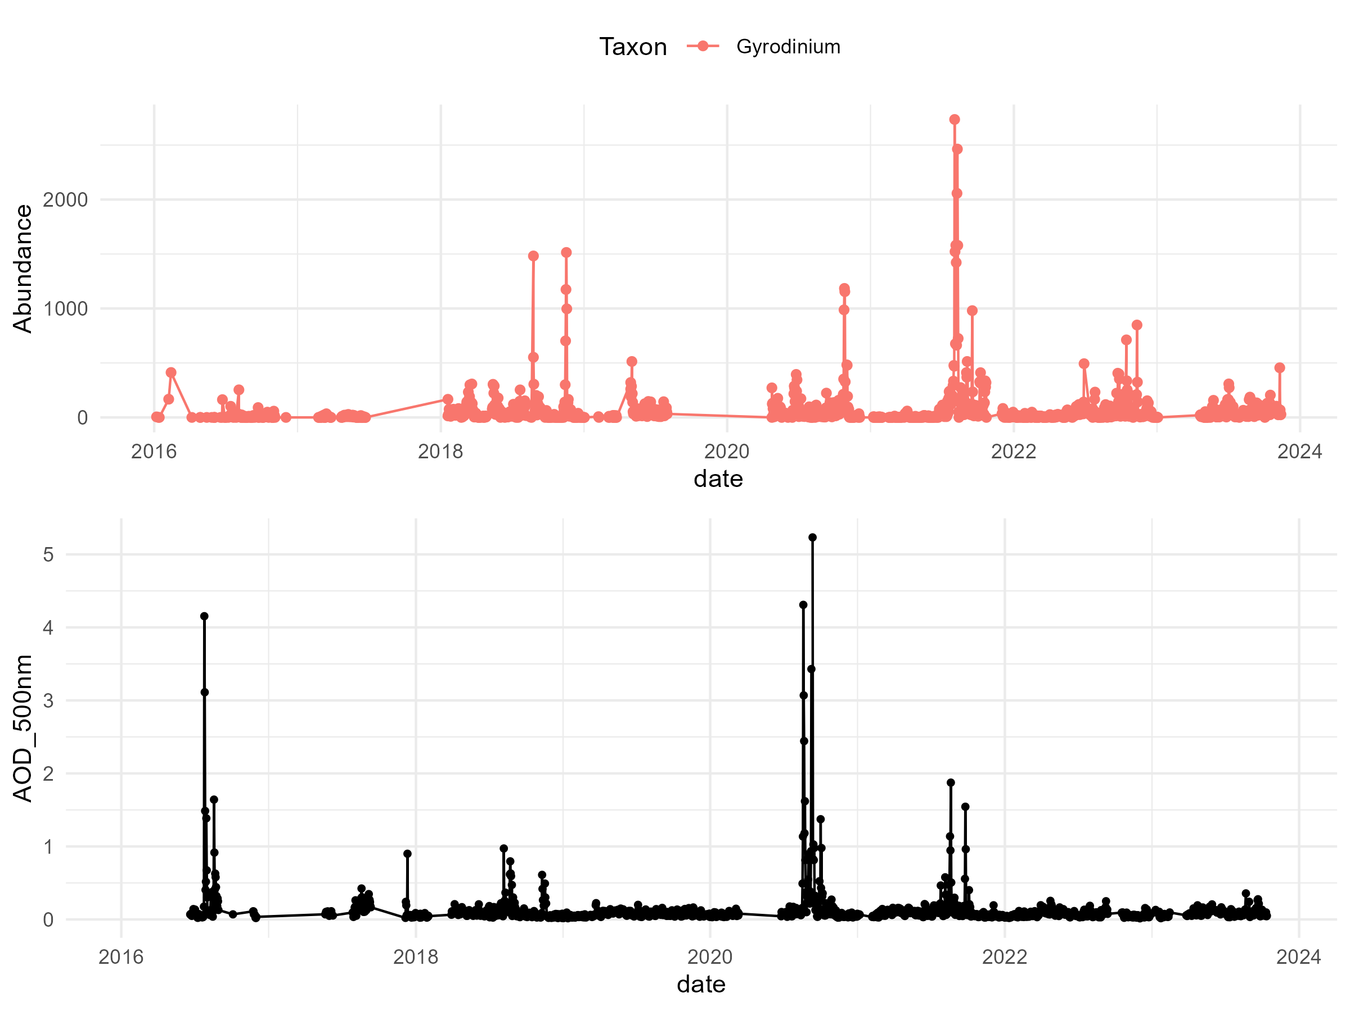
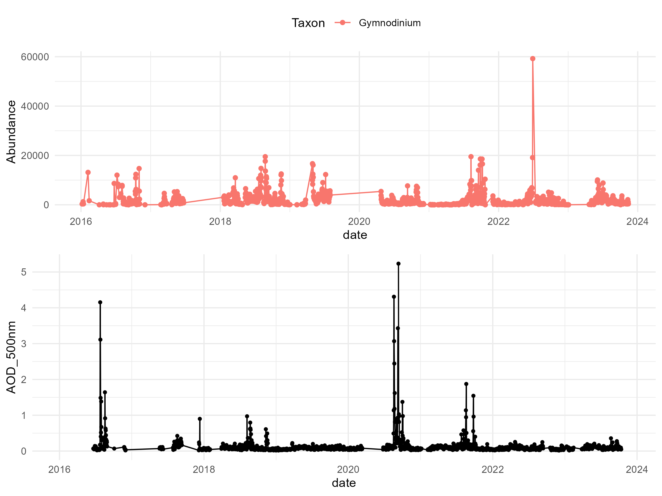
Taxa vs AOD

Slide 15
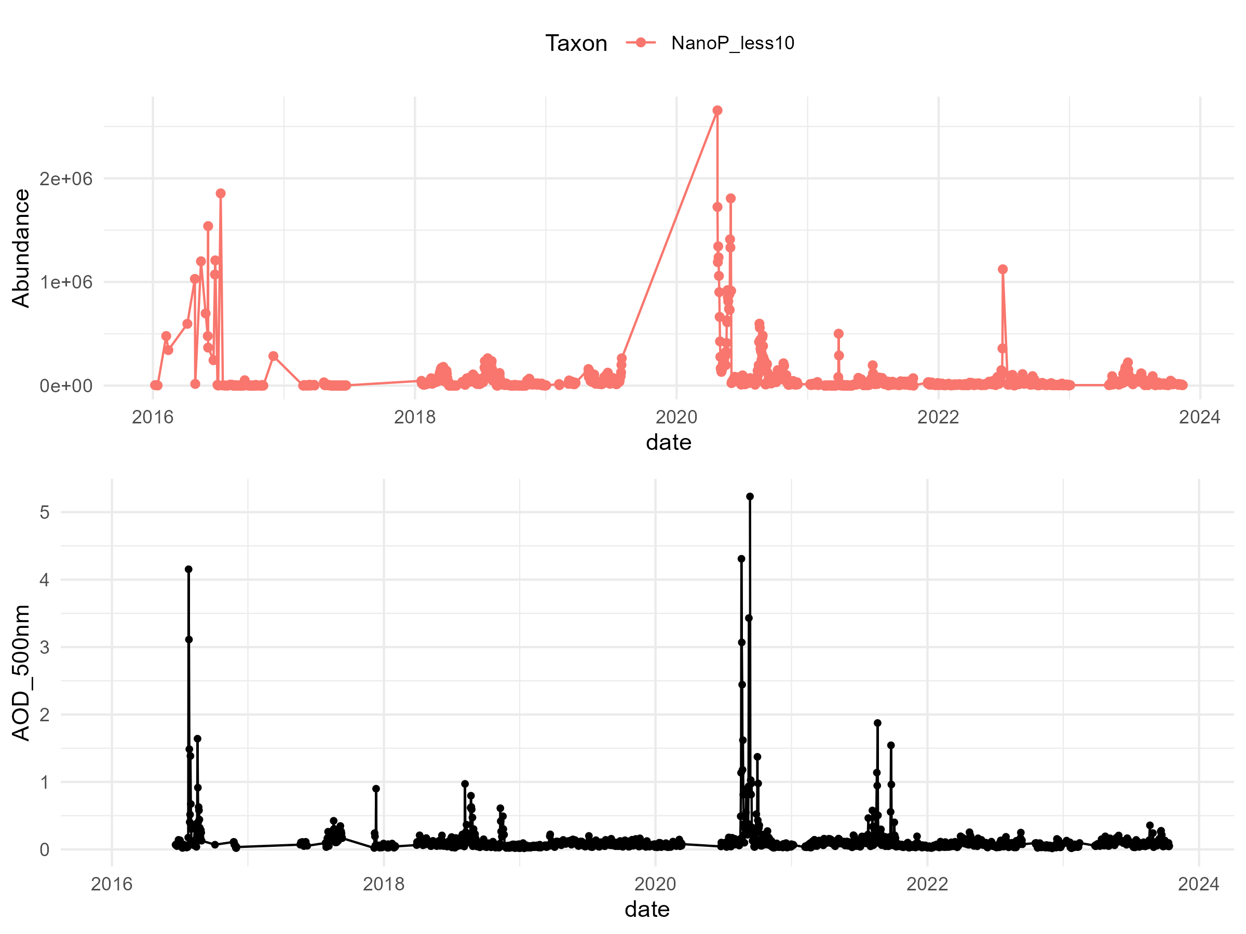
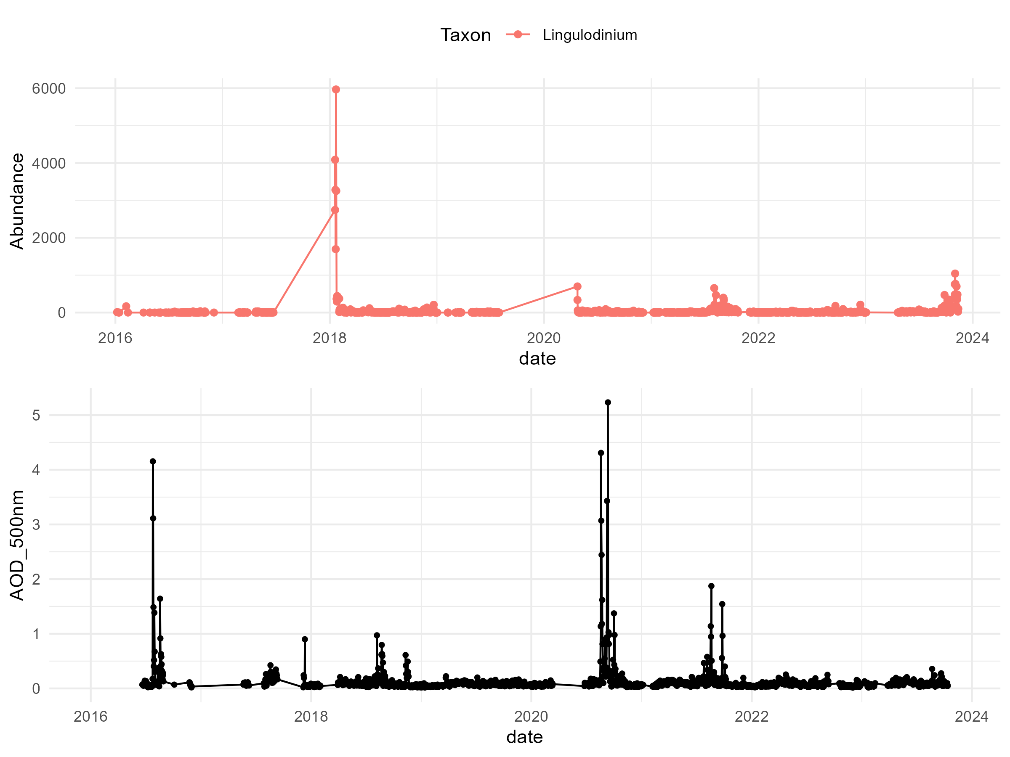
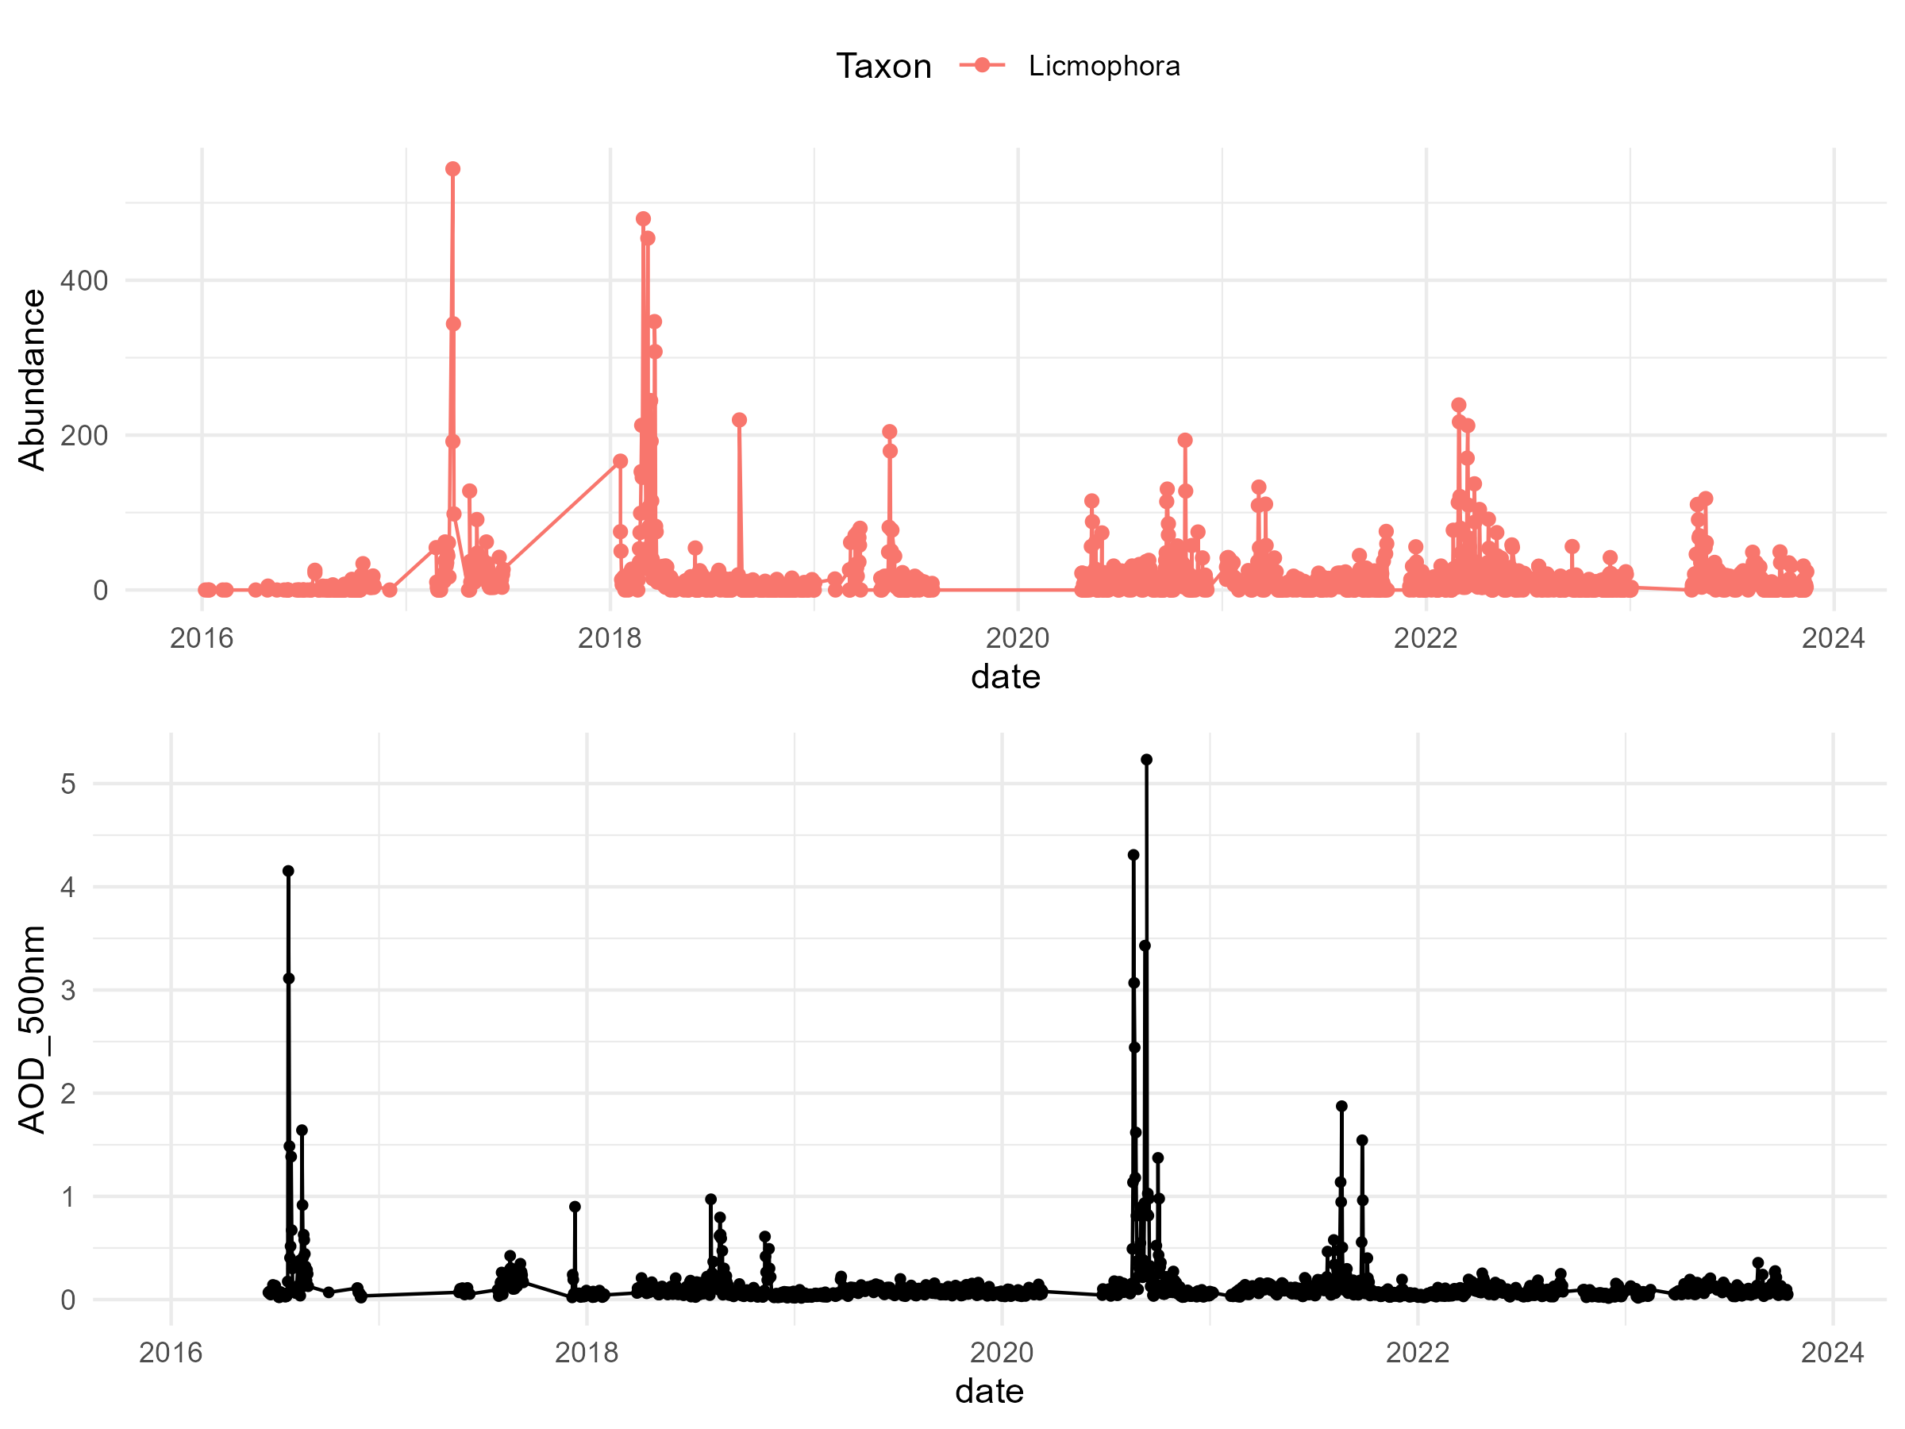
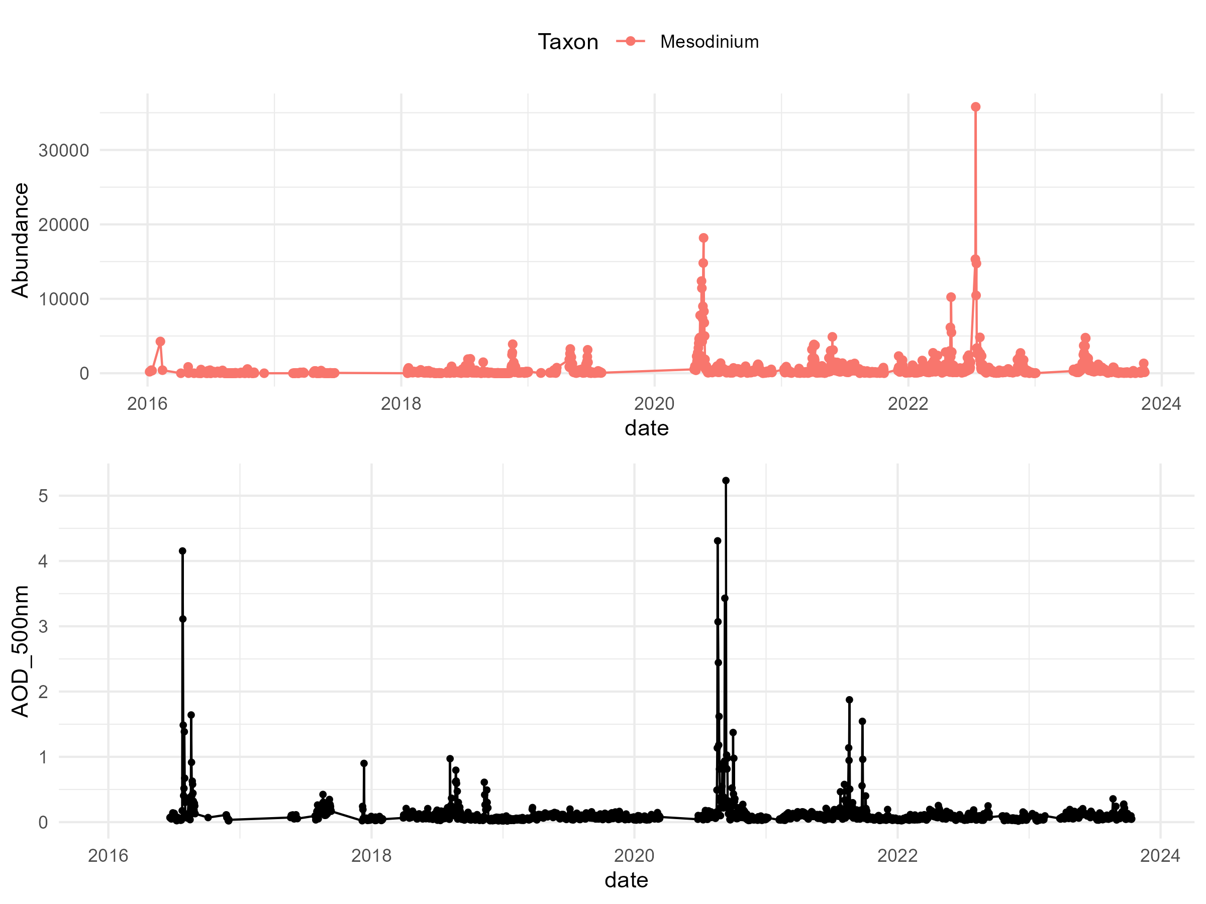
Taxa vs AOD

Slide 16
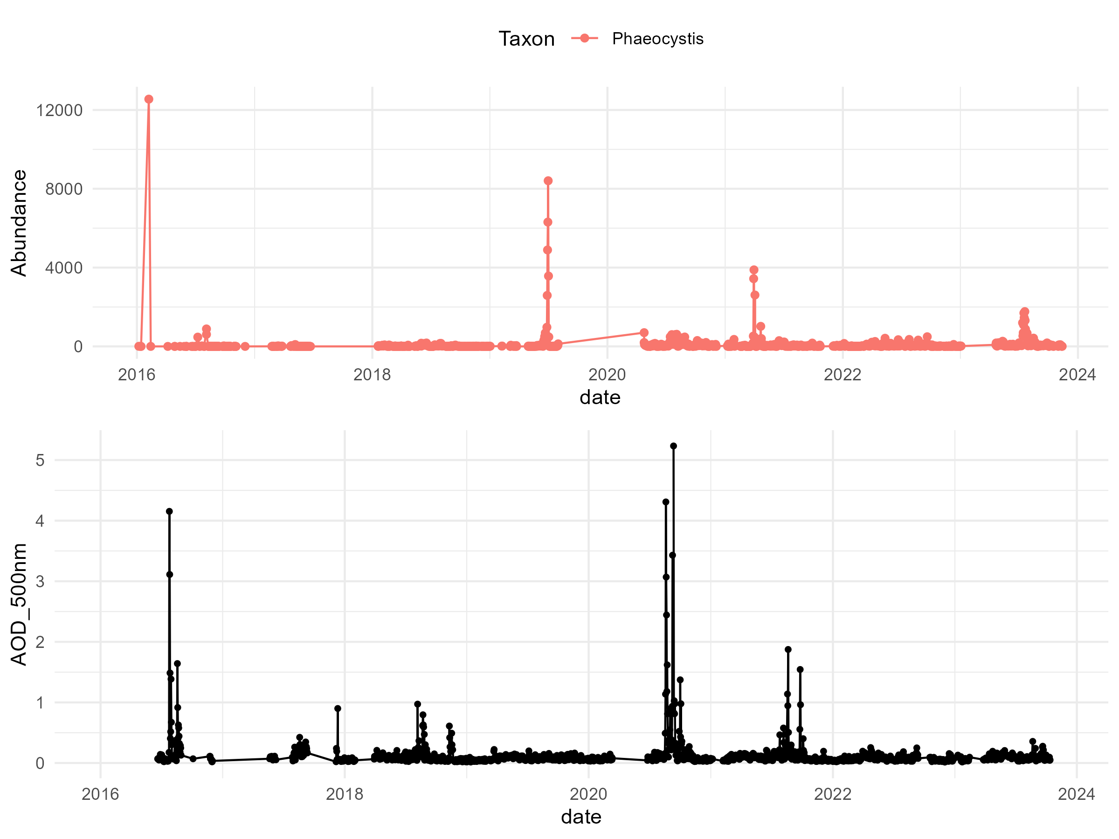
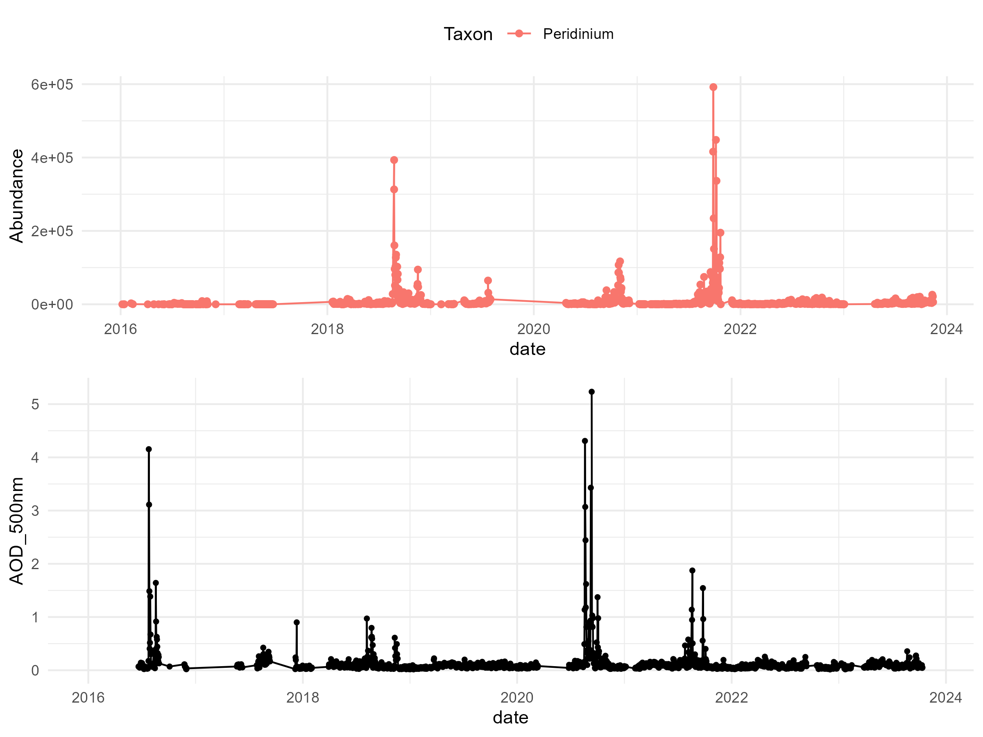
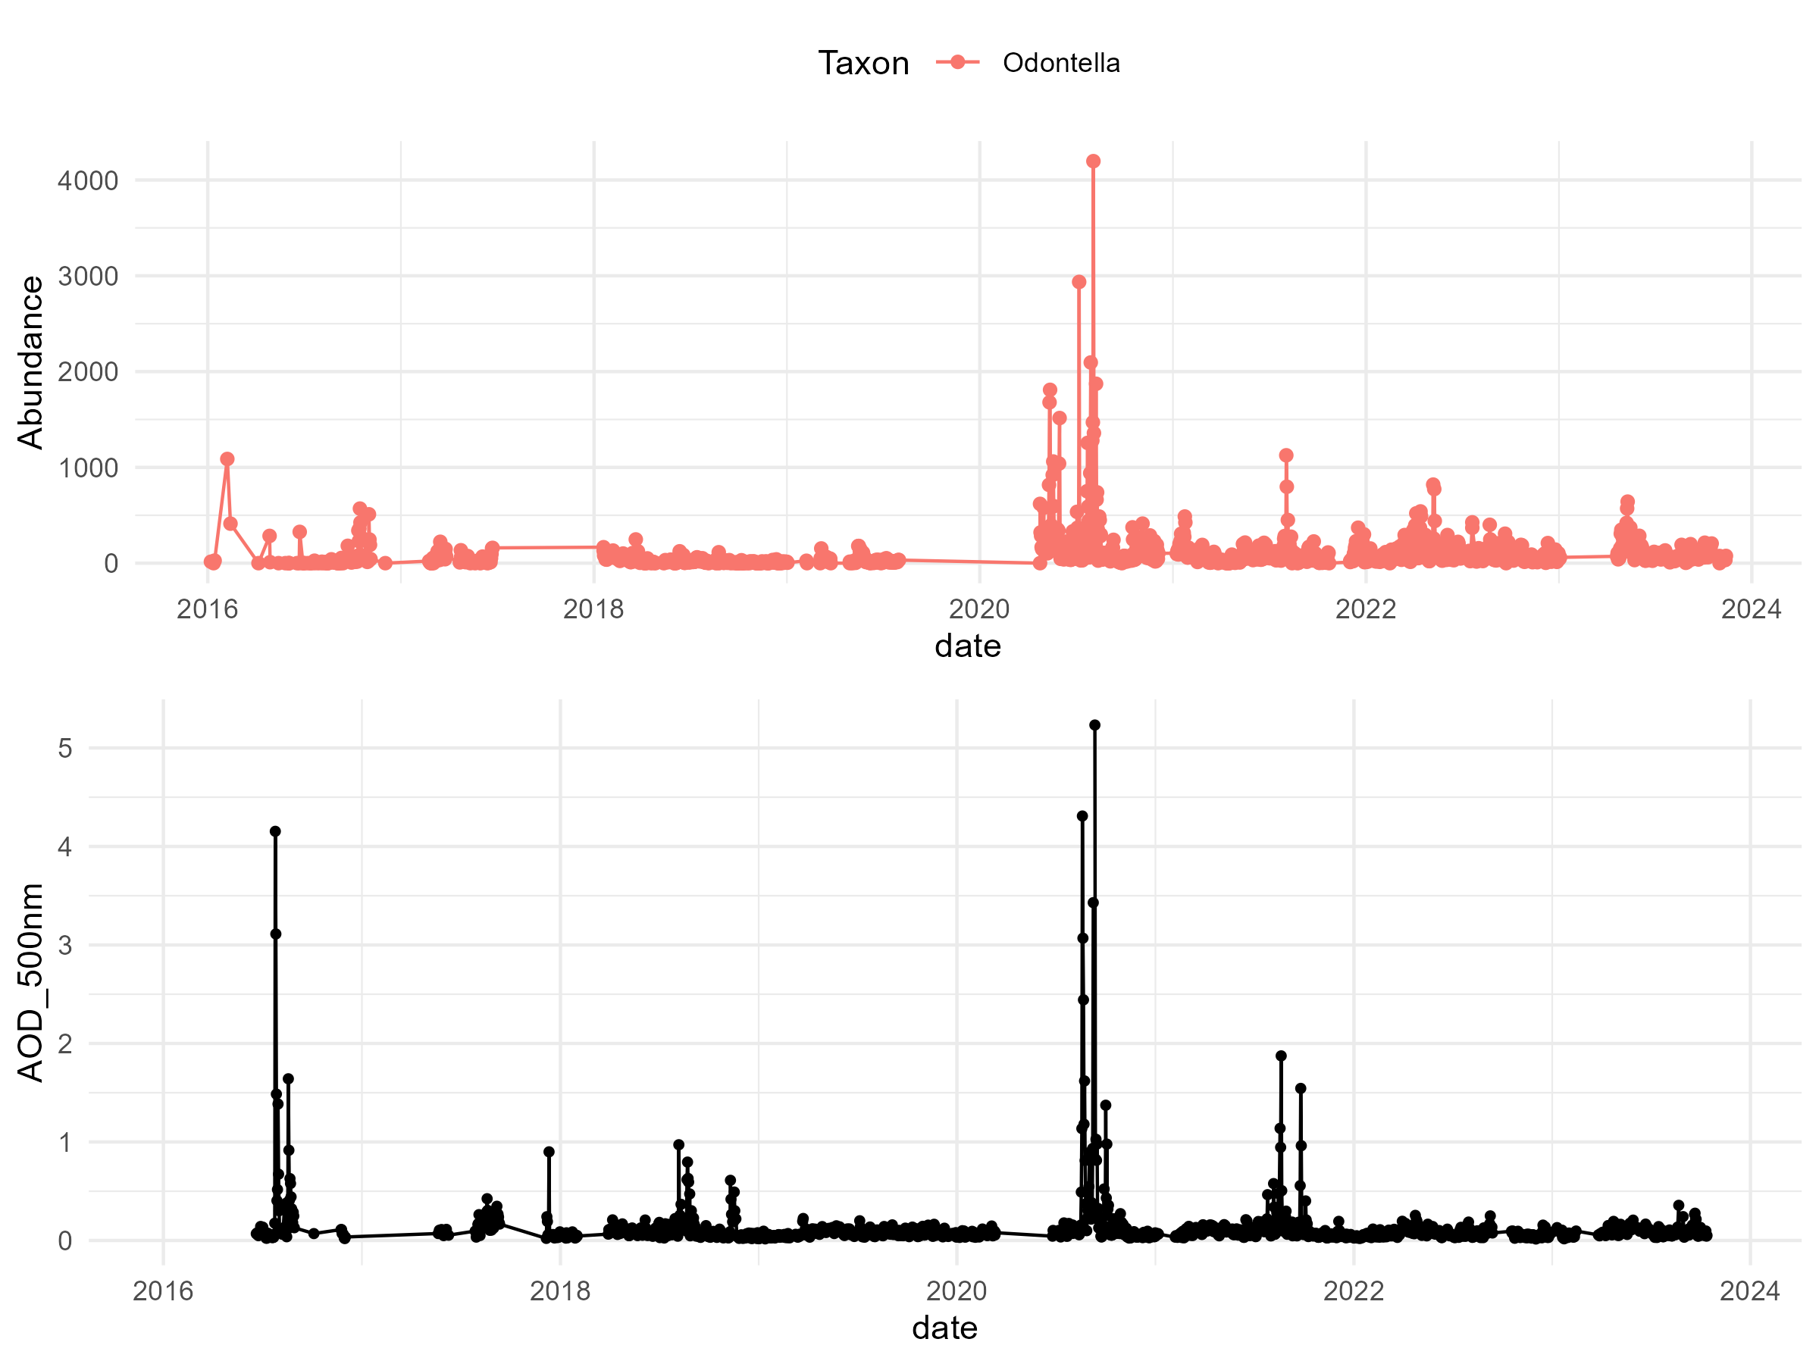
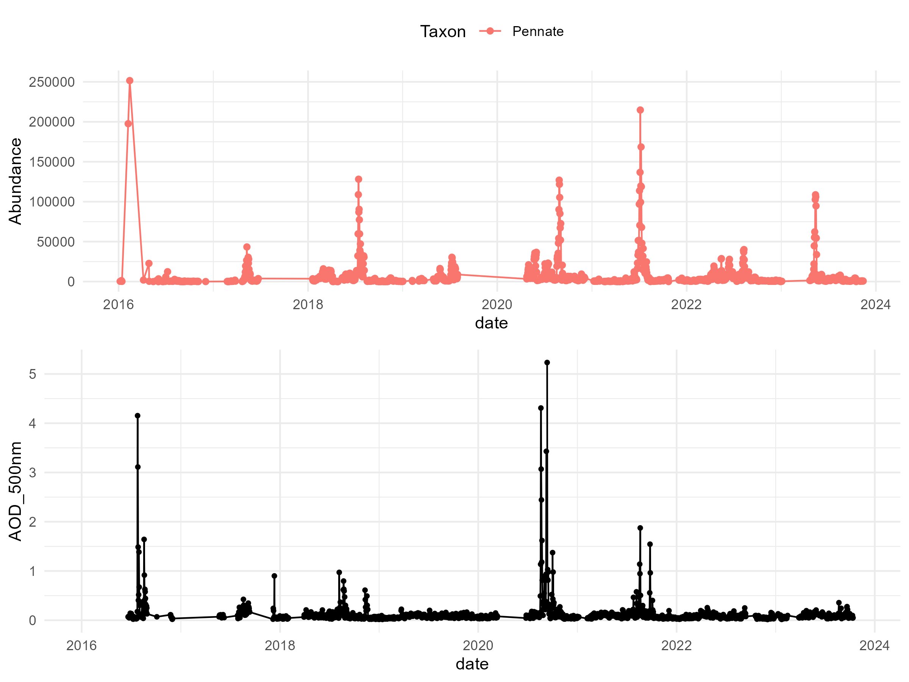
Taxa vs AOD

Slide 17
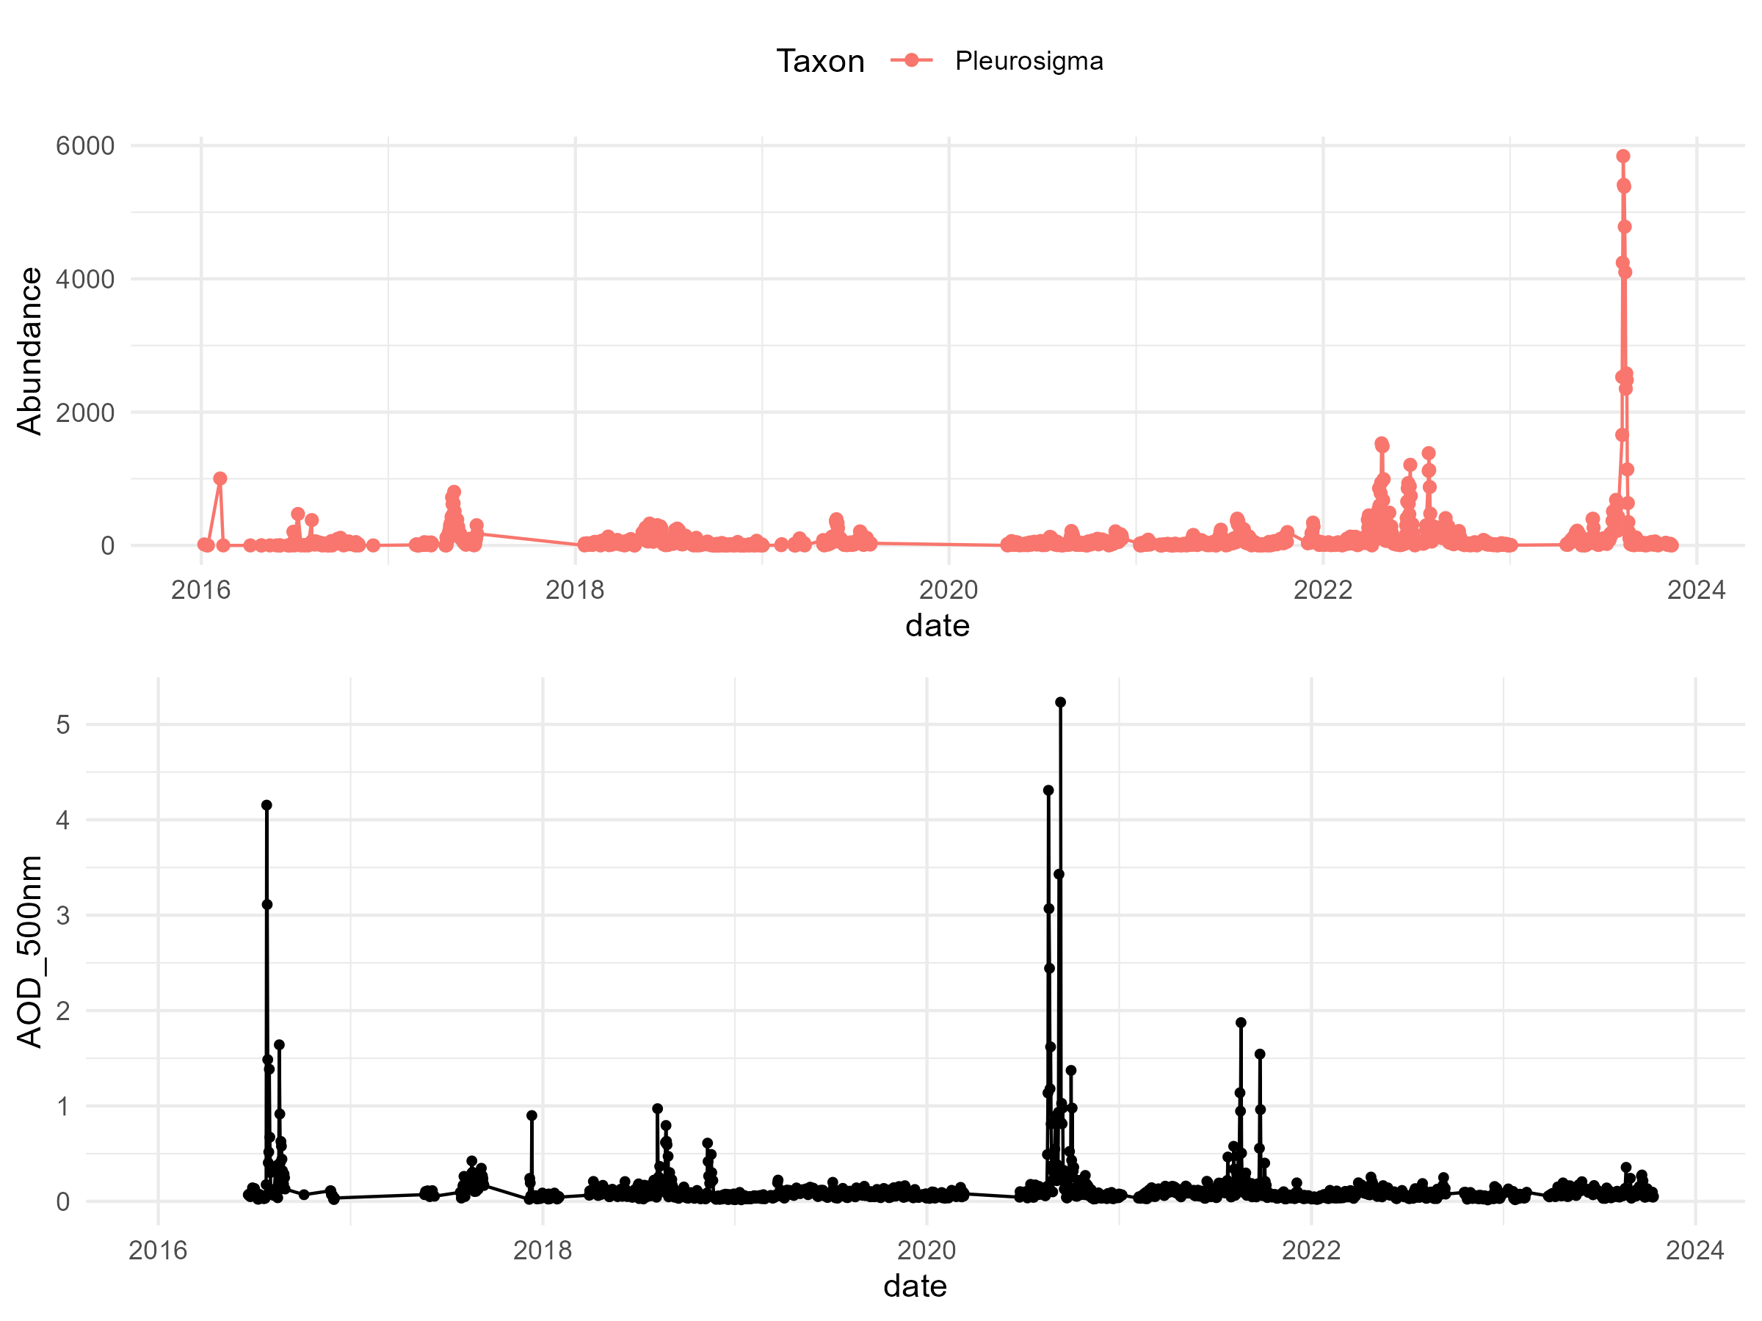
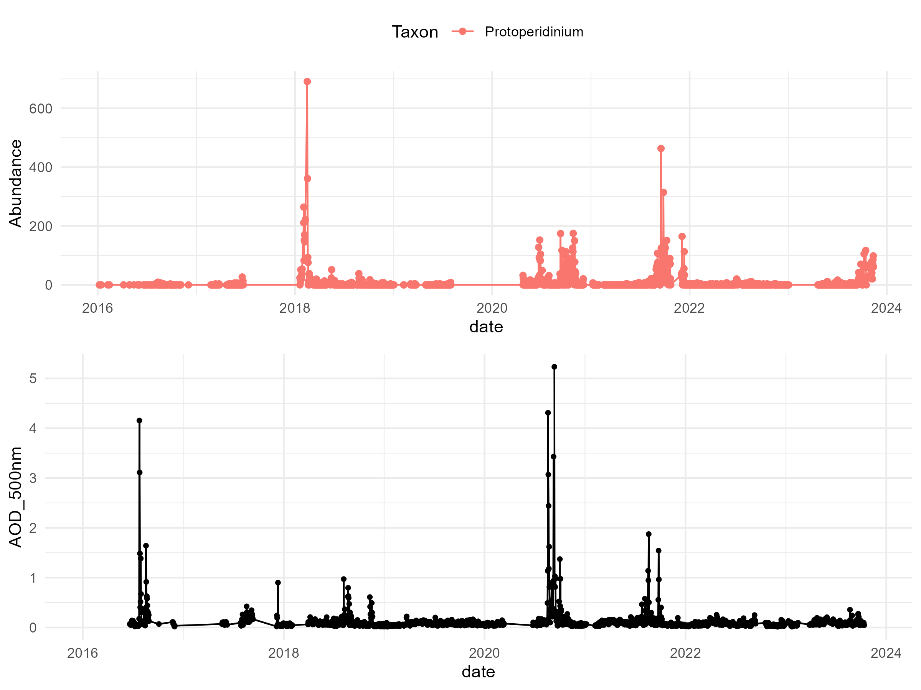
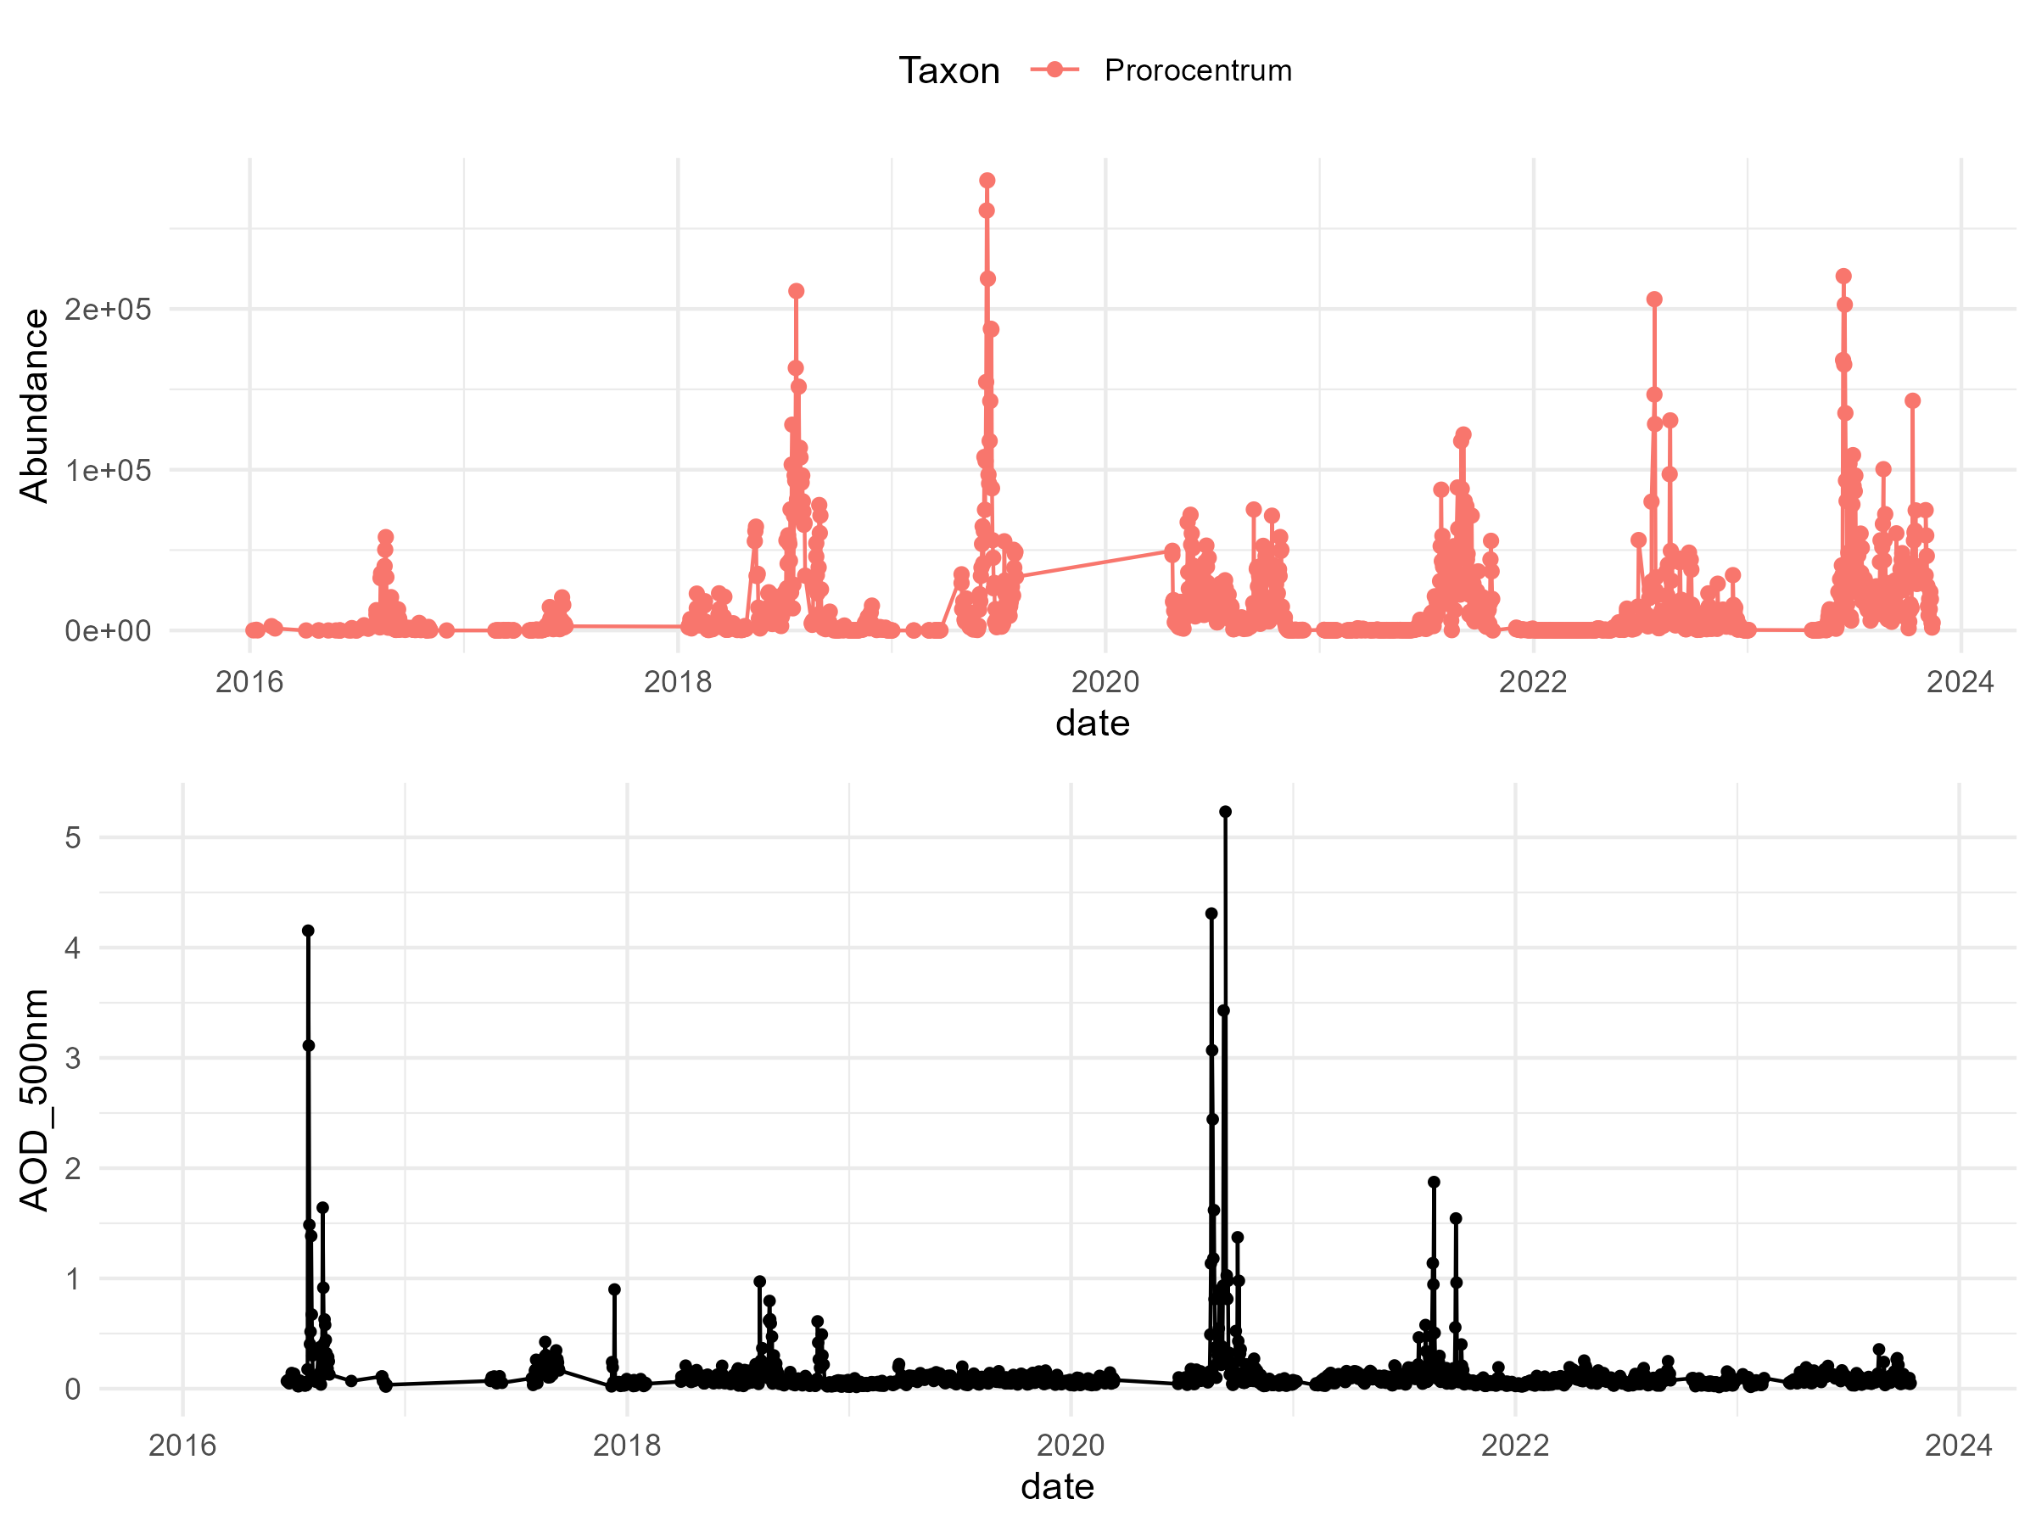
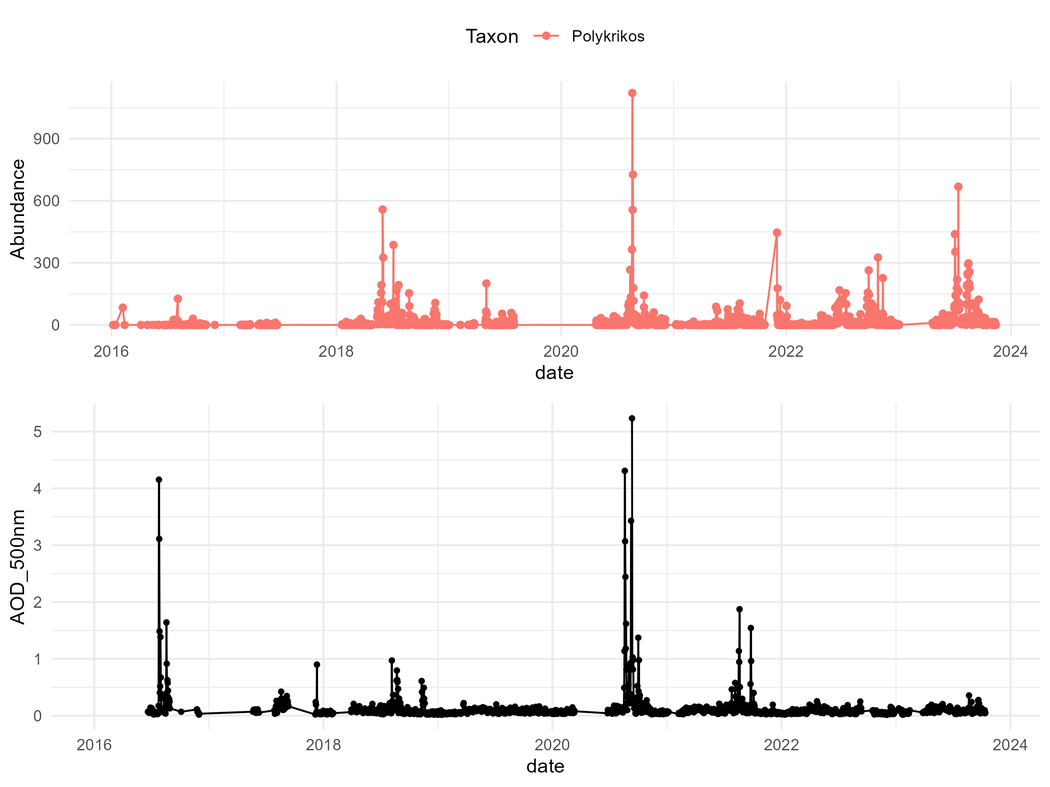
Taxa vs AOD

Slide 18
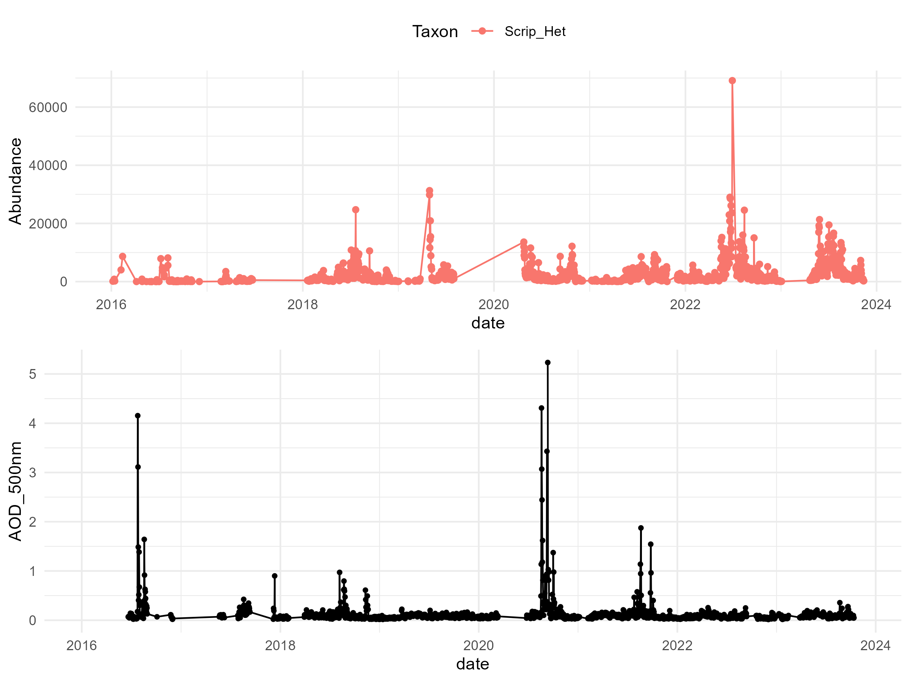
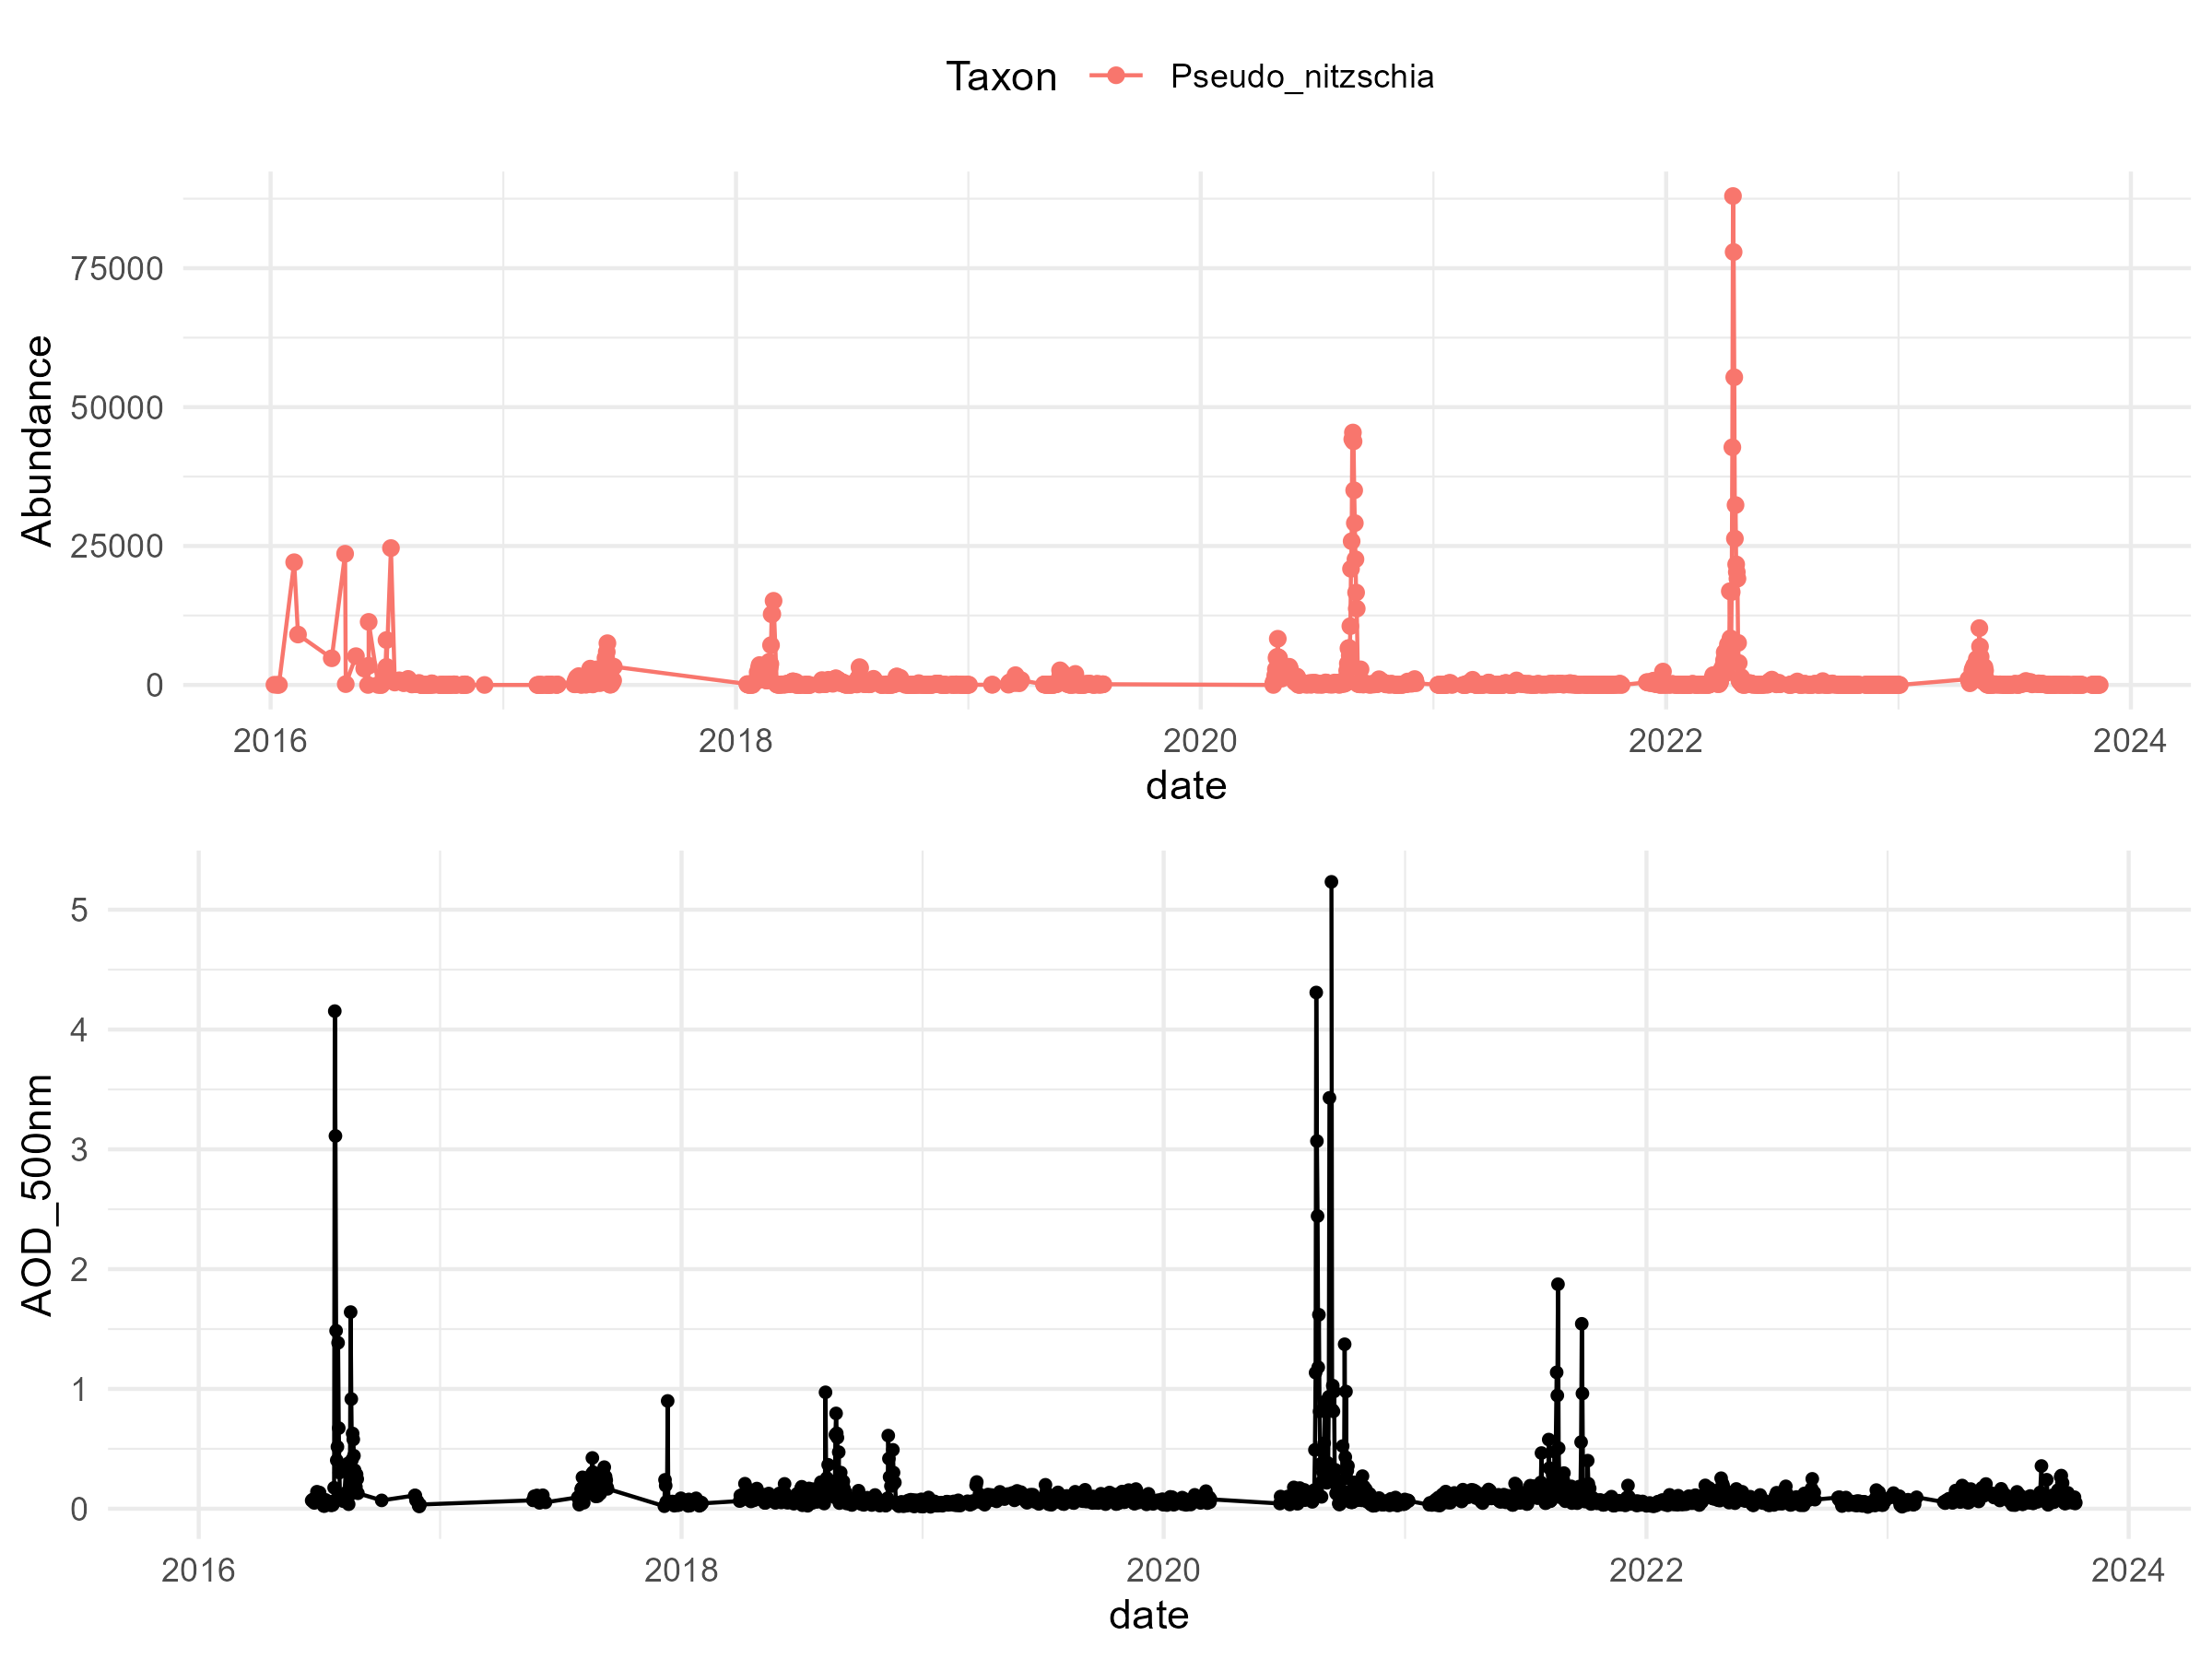
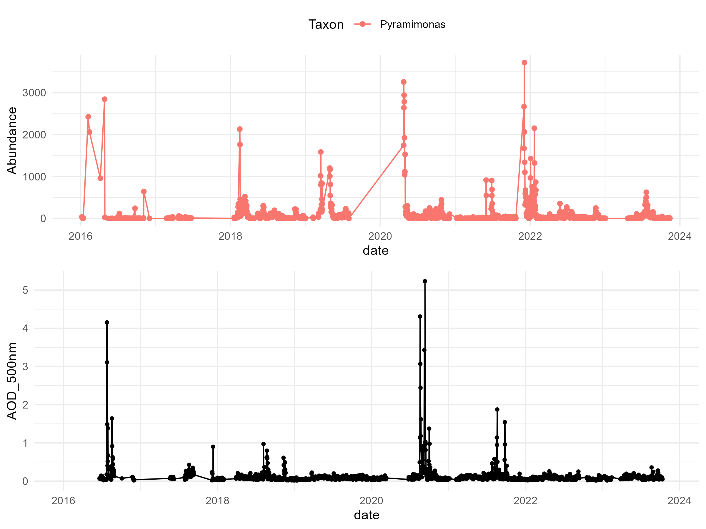
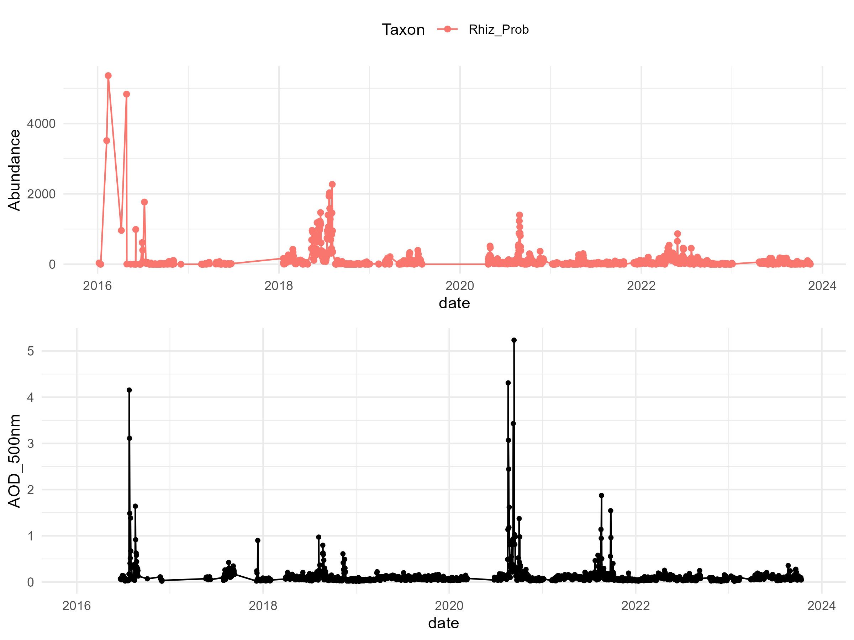
Taxa vs AOD

Slide 19




Taxa vs AOD

Slide 20




Taxa vs AOD

Slide 21


Taxa vs AOD

Slide 22
Taxa with responses
"Akashiwo"
"Alexandrium_singlet
"Asterionellopsis“*
"Boreadinium"
"Centric“*
"Chaetoceros"*
"Cyl_Nitz“
"diatoms"
"Det_Cer_Lau"*
"Entomoneis”
"Guin_Dact"*
"Hemiaulus“*
"Leptocylindrus“*
"Odontella"
"Pennate"
"Peridinium”
"Polykrikos“*
"Pseudo_nitzschia”*
"Rhiz_Prob"
"Skeletonema“*
"Thalassionema“*
"Thalassiosira" *
*Stronger responses (Visually)

Slide 23
Bray Curtis

Slide 24

Pairwise Bray Curtis

Slide 25

Pairwise Bray Curtis

Slide 26
Cross Correlation
Phytoplankton abundances x AOD

Slide 27

1500 days lags

Slide 28

500 days lags

Slide 29

50 days lags

Slide 30

50 days lags with climatology removed

Slide 31
Takeaway
Particular phytoplankton groups display a strong lagged response to wildfire-associated extremes in aerosol optical depth at a lag of ~10-14 days
Asterionellopsis | Diatom
Hemiaulus | Diatom
Skeletonema | Diatom
Centric | Diatom
Leptocylindrus | Diatom
Thalassionema | Diatom
How do the abundances of these taxa compare to their typical abundances?

Slide 32







PDFs for Response Taxa vs. All data During 8-10/2020
Response taxa=taxa where correlation coefficient >0.5

Slide 33
Other Physical Drivers
Winds: NDBC Buoy 46042
River Discharge: San Lorenzo Outflow
Nutrients: HABS weekly nitrate, phosphate, silicate
Upwelling: BEUTI index at 37deg
SST: Using Moss Landing Marine Lab SST (more complete data)
NPGO: Monthly
MEI: Monthly

Slide 34

Other potential forcings

Slide 35

Other potential forcings

Slide 36
Next steps

Slide 37
IFCB Analysis
Expand analysis to Biovolume

Slide 38
Other Shore Station Responses
Bodega Bay
Humboldt
Santa Cruz with 2021 fires (

Slide 39
Satellite Chlorophyll and Black Carbon Comparison

Slide 40
Useful papers to reference
Fischer, A.D., Hayashi, K., McGaraghan, A. and Kudela, R.M., 2020. Return of the “age of dinoflagellates” in Monterey Bay: Drivers of dinoflagellate dominance examined using automated imaging flow cytometry and long‐term time series analysis. Limnology and Oceanography, 65(9), pp.2125-2141.
Schulien, J.A., Peacock, M.B., Hayashi, K., Raimondi, P. and Kudela, R.M., 2017. Phytoplankton and microbial abundance and bloom dynamics in the upwelling shadow of Monterey Bay, California, from 2006 to 2013. Marine Ecology Progress Series, 572, pp.43-56.

